Slide 1
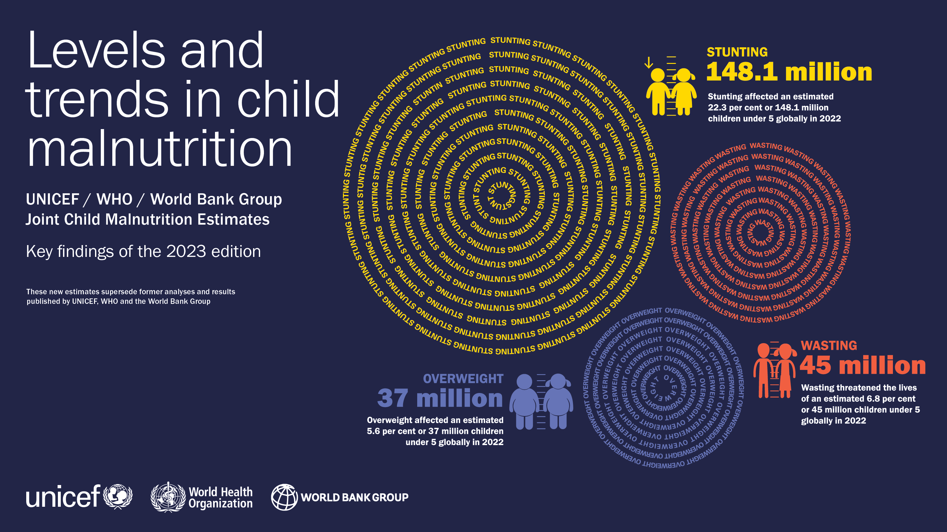

Slide 2

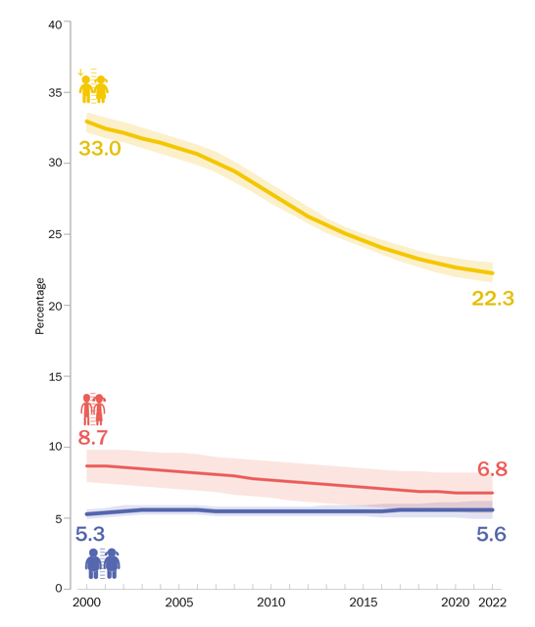
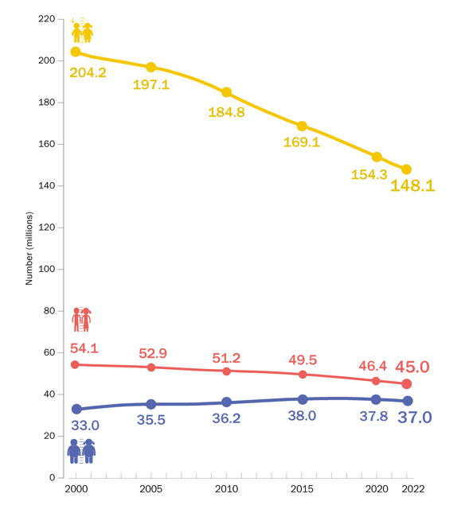
GLOBAL OVERVIEW
Prevalence and Number (millions) affected
Stunting has declined steadily since 2000 – but faster progress is needed to reach the 2030 target.
Wasting persists at alarming rates and overweight will require a reversal in trajectory if the 2030 target is to be achieved.
Percentage of children under 5 affected by stunting, wasting and overweight, global, 2000–2022
Number (millions) of children under 5 affected by stunting, wasting and overweight, global, 2000–2022
Source: UNICEF, WHO, World Bank Group Joint Child Malnutrition Estimates, 2023 edition.

Slide 3
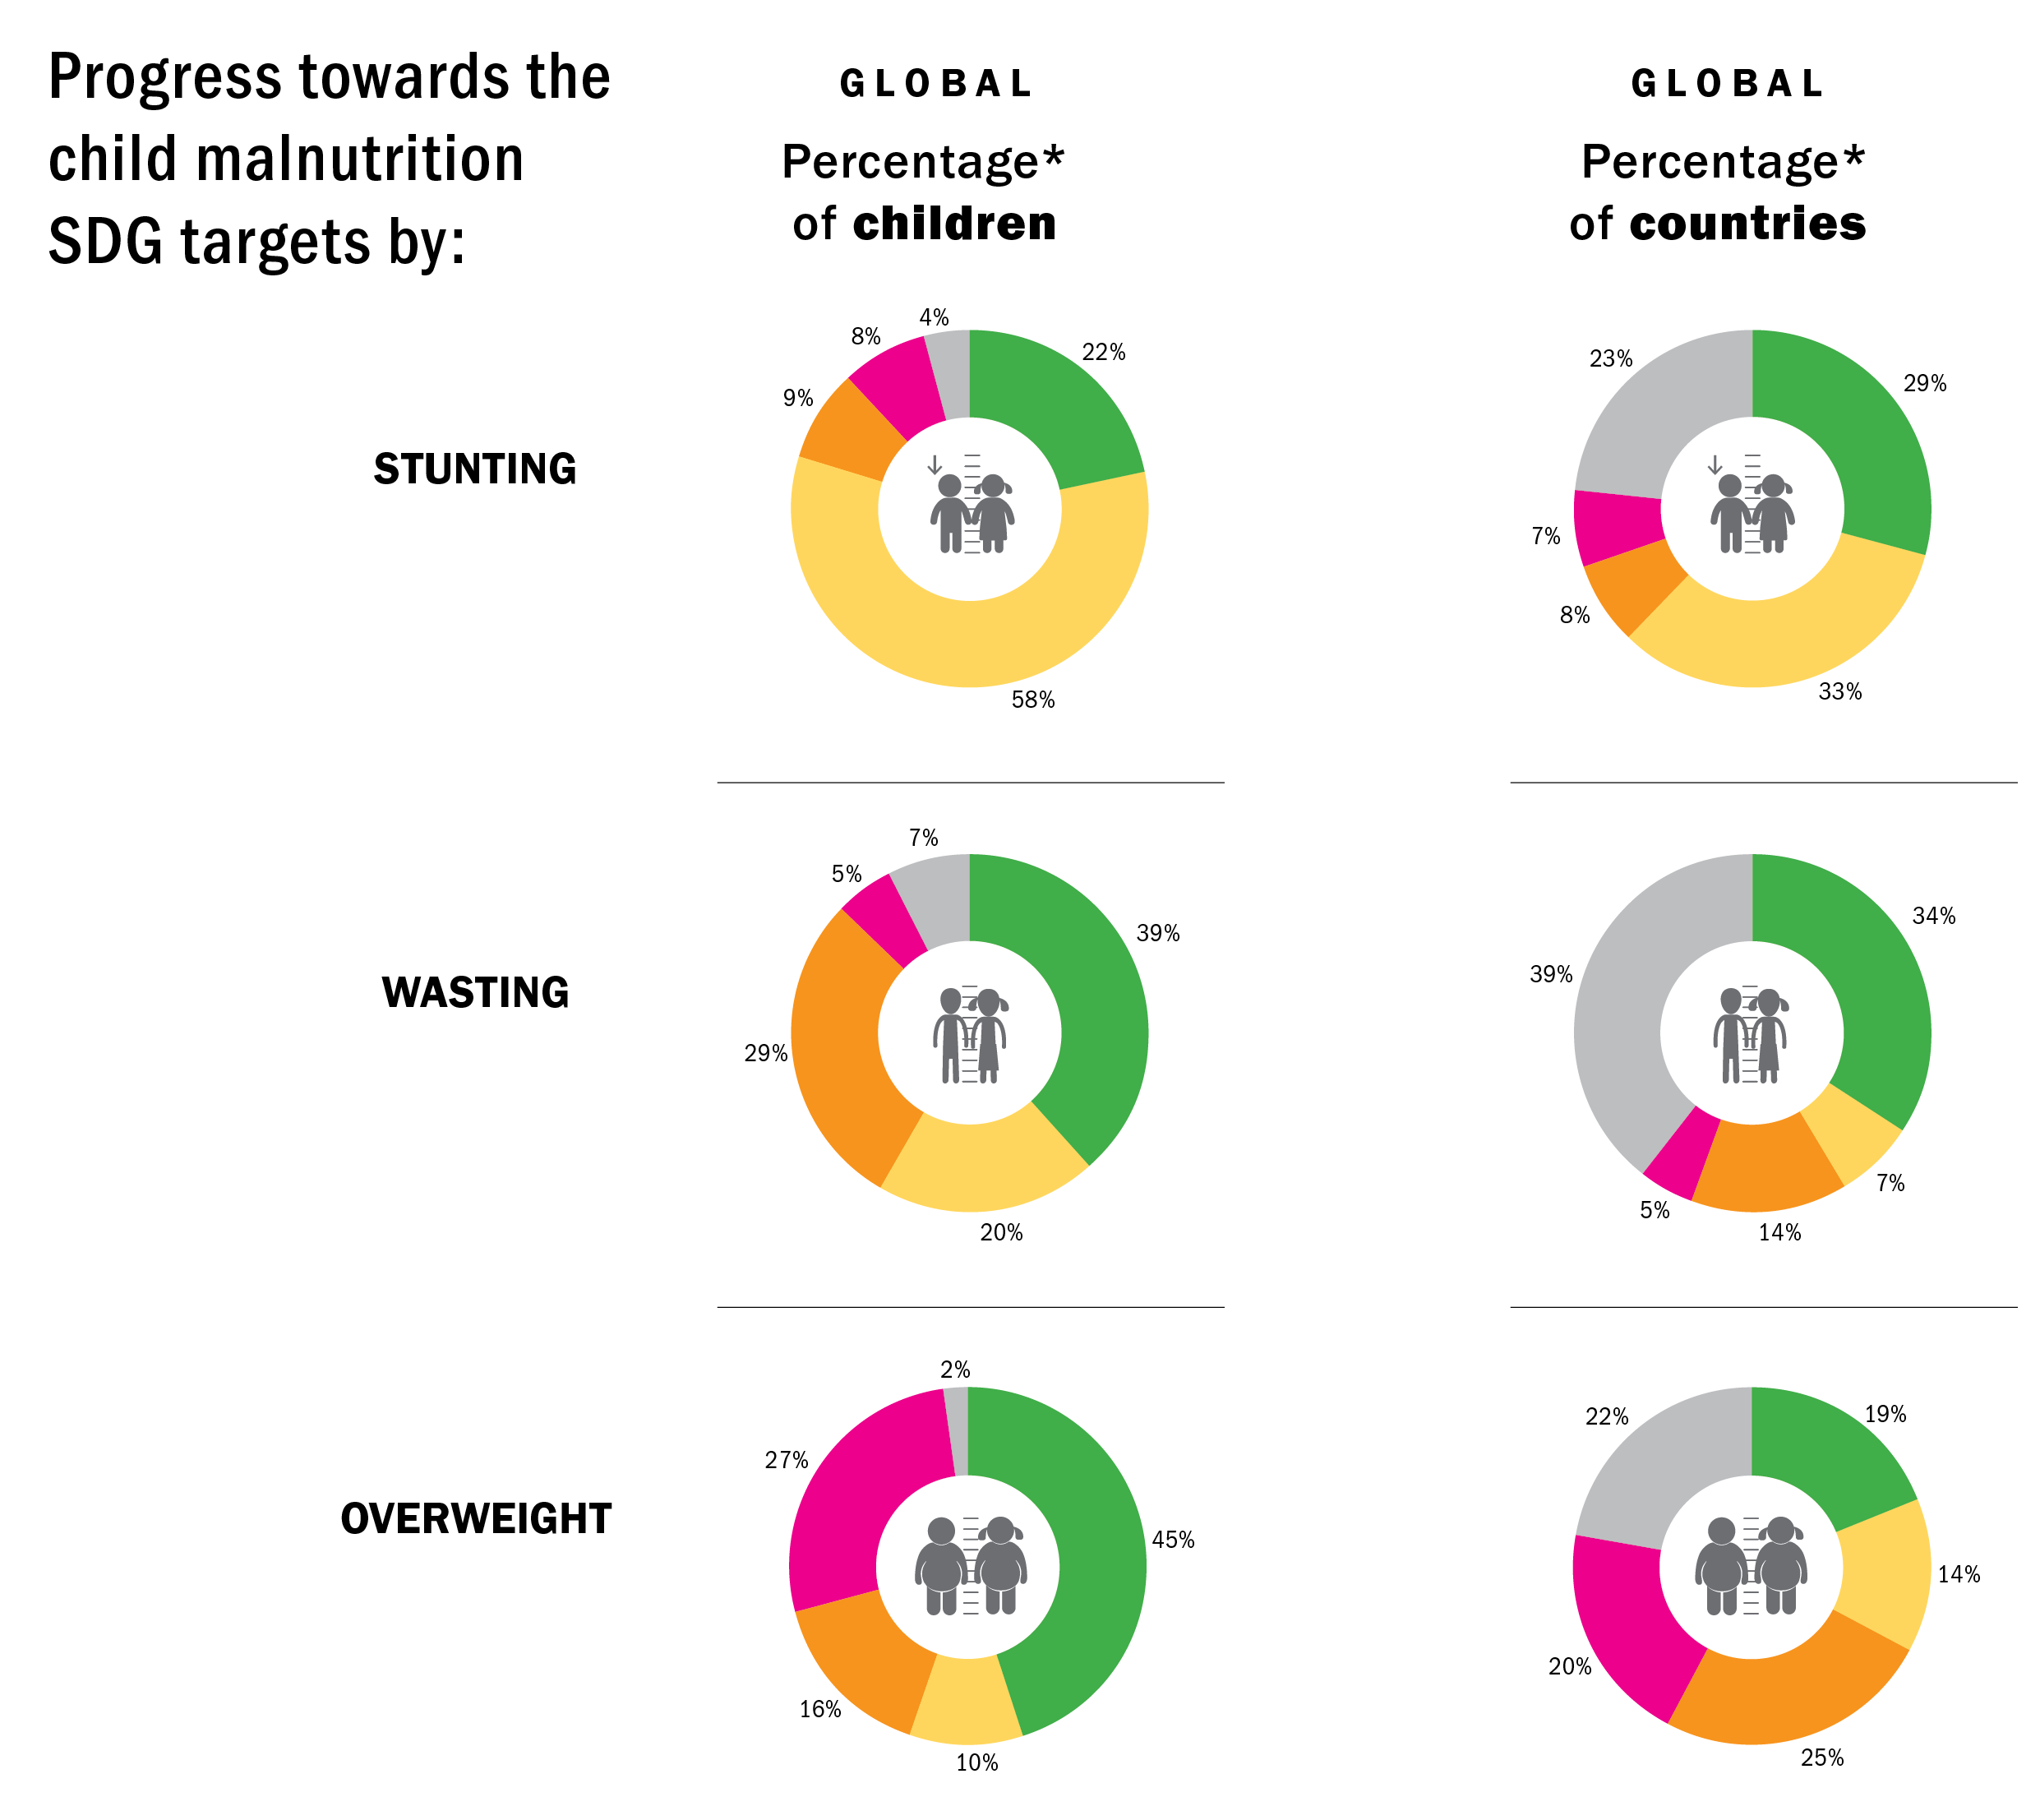
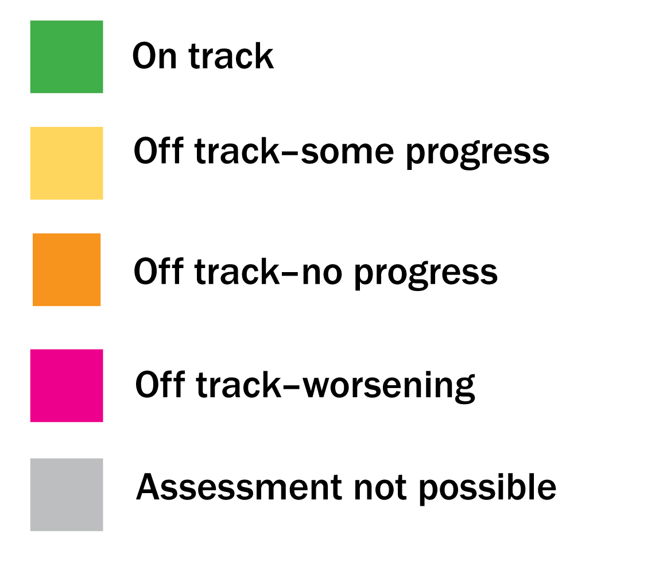
GLOBAL OVERVIEW
Progress toward the SDGs by % of population and % of countries global
Three quarters of the world’s children live in countries that are off-track to achieve the 2030 SDG target on child stunting
Source: UNICEF, WHO, World Bank Group Joint Malnutrition Estimates, 2023 edition. Note: *Percentages may not add up to 100 per cent due to rounding. See notes on progress assessment categories on slide 31.

Slide 4
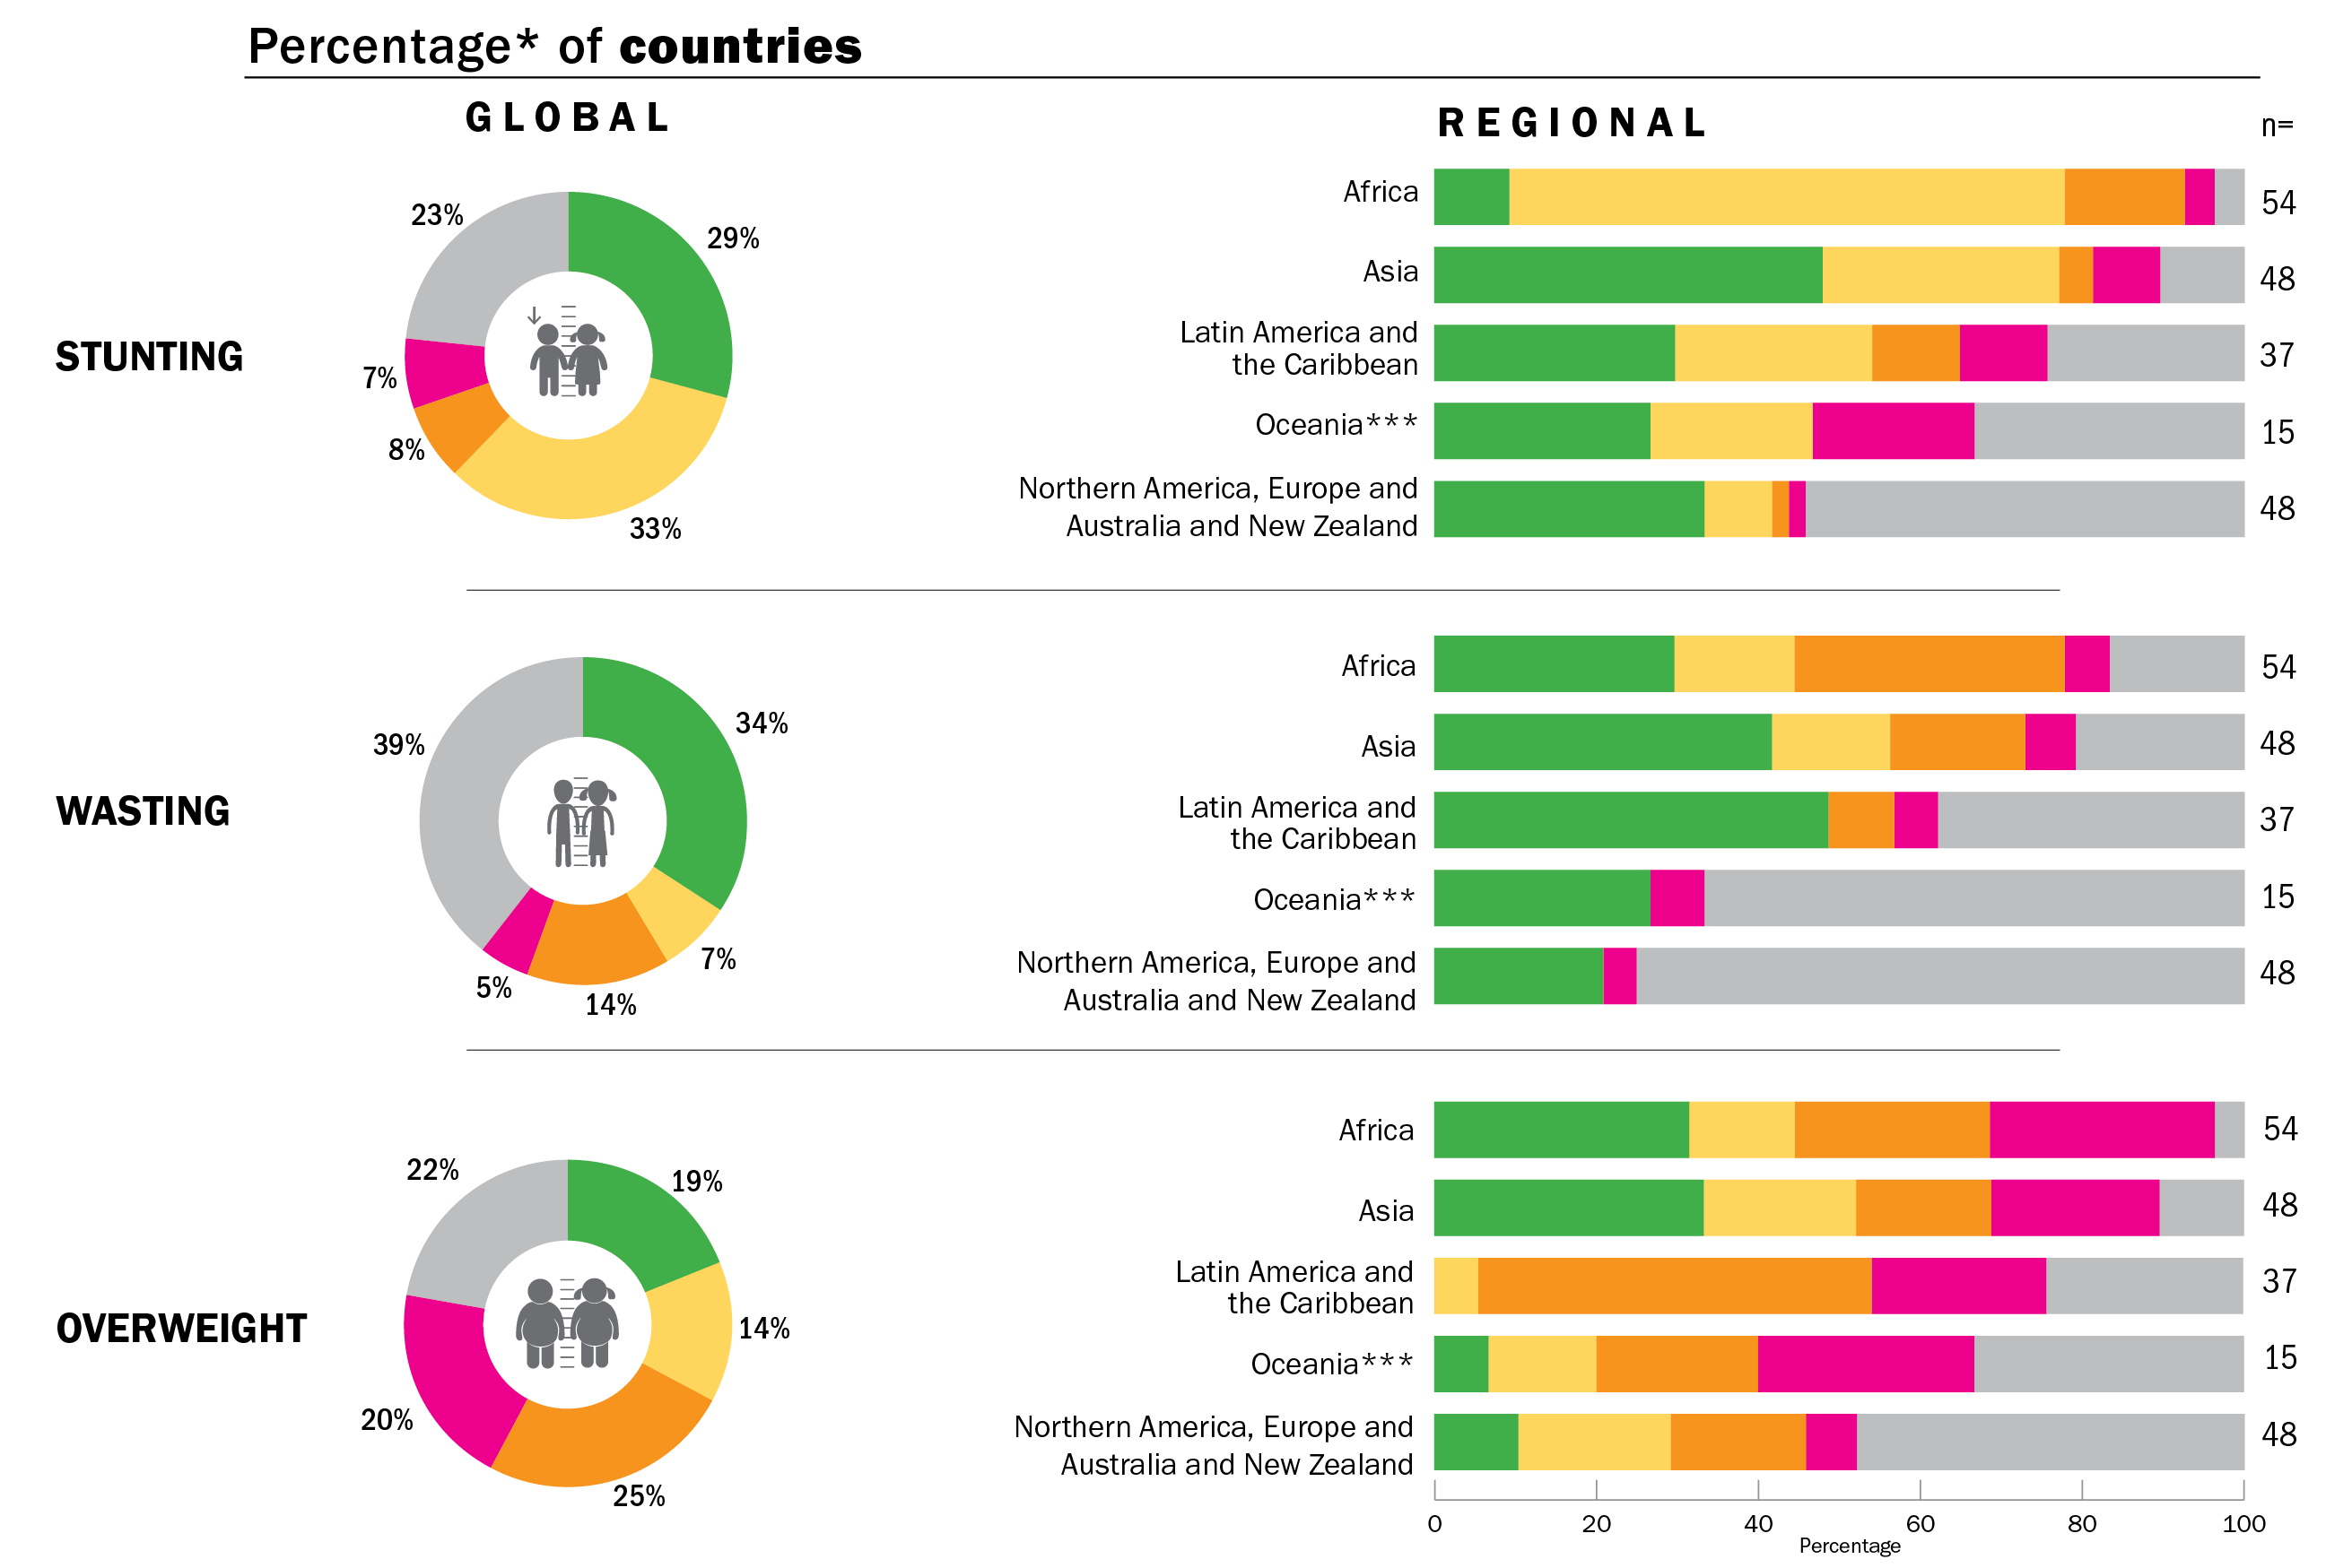
GLOBAL OVERVIEW
Progress toward the SDGs – by % of countries global & regional
Only about one quarter of countries are on track to achieve at least one of the 2030 SDG targets on stunting and wasting while fewer than two in five countries are on track to achieve the target on overweight
Progress towards the child malnutrition SDG targets by:
Source: UNICEF, WHO, World Bank Group Joint Malnutrition Estimates, 2023 edition. Note: *Percentages may not add up to 100 per cent due to rounding. **Oceania excluding Australia and New Zealand. See notes on progress assessment categories on slide 31.

Slide 5
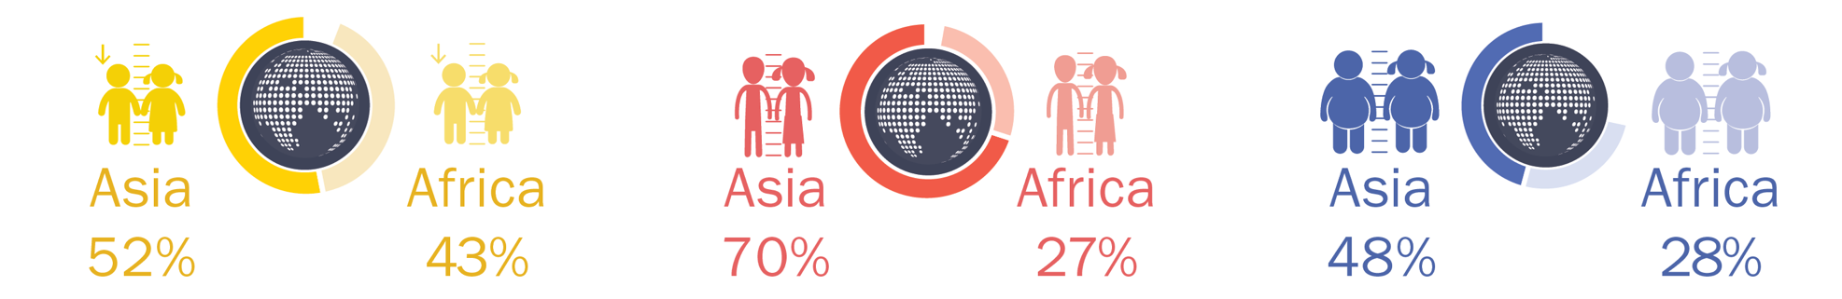
GLOBAL OVERVIEW
Most children with malnutrition live in Africa and Asia
In 2022, more than half of all children under 5 affected by stunting lived in Asia and two out of five lived in Africa
In 2022, more than two thirds of all children under 5 affected by wasting lived in Asia and more than one quarter lived in Africa.
In 2022, almost half of all children under 5 affected by overweight lived in Asia and more than one quarter lived in Africa.
Source: UNICEF, WHO, World Bank Group Joint Child Malnutrition Estimates, 2023 edition.

Slide 6
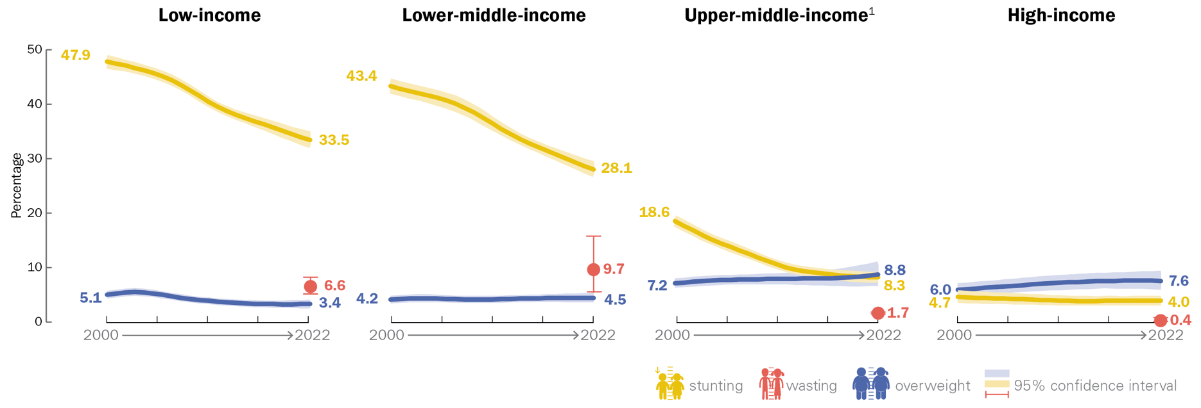
COUNTRY INCOME CLASSIFICATION
Prevalence: Stunting, Wasting and Overweight, 2000–2022
Percentage of children under 5 affected by stunting, wasting and overweight, by country income classification, 2000–2022
Source: UNICEF, WHO, World Bank Group Joint Malnutrition Estimates, 2023 edition. Note: 1. Upper-middle-income countries wasting estimate: consecutive low (<50 per cent) population coverage for country data (e.g., from household surveys); interpret with caution.

Slide 7
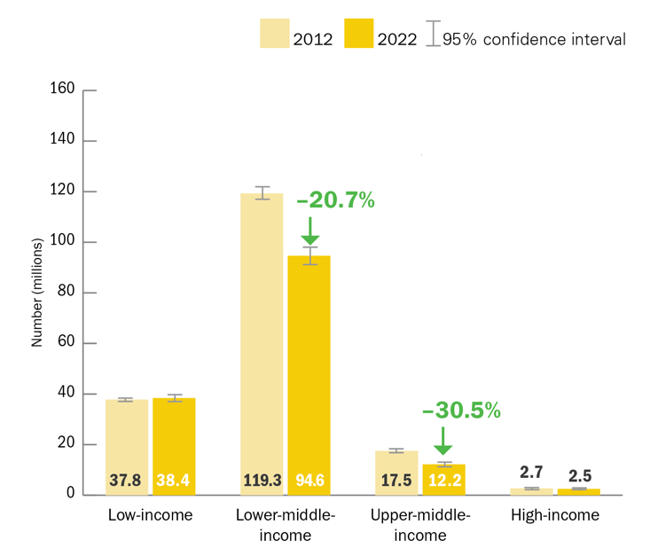
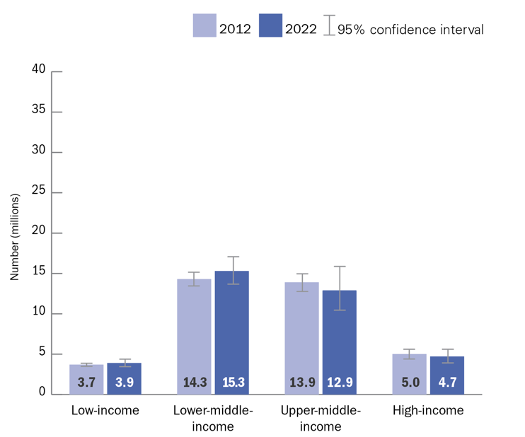
COUNTRY INCOME CLASSIFICATION
Number (millions) affected: Stunting and Overweight, 2012–2022
Number (millions) of children under 5 affected by stunting, by country income classification, 2012 and 2022
Number (millions) of children under 5 affected by overweight, by country income classification, 2012 and 2022
Source: UNICEF, WHO, World Bank Group Joint Malnutrition Estimates, 2023 edition.
Note: The values for “percentage change since 2012” are based on calculations using unrounded estimates and therefore might not match values calculated using the rounded estimates presented in this report.

Slide 8
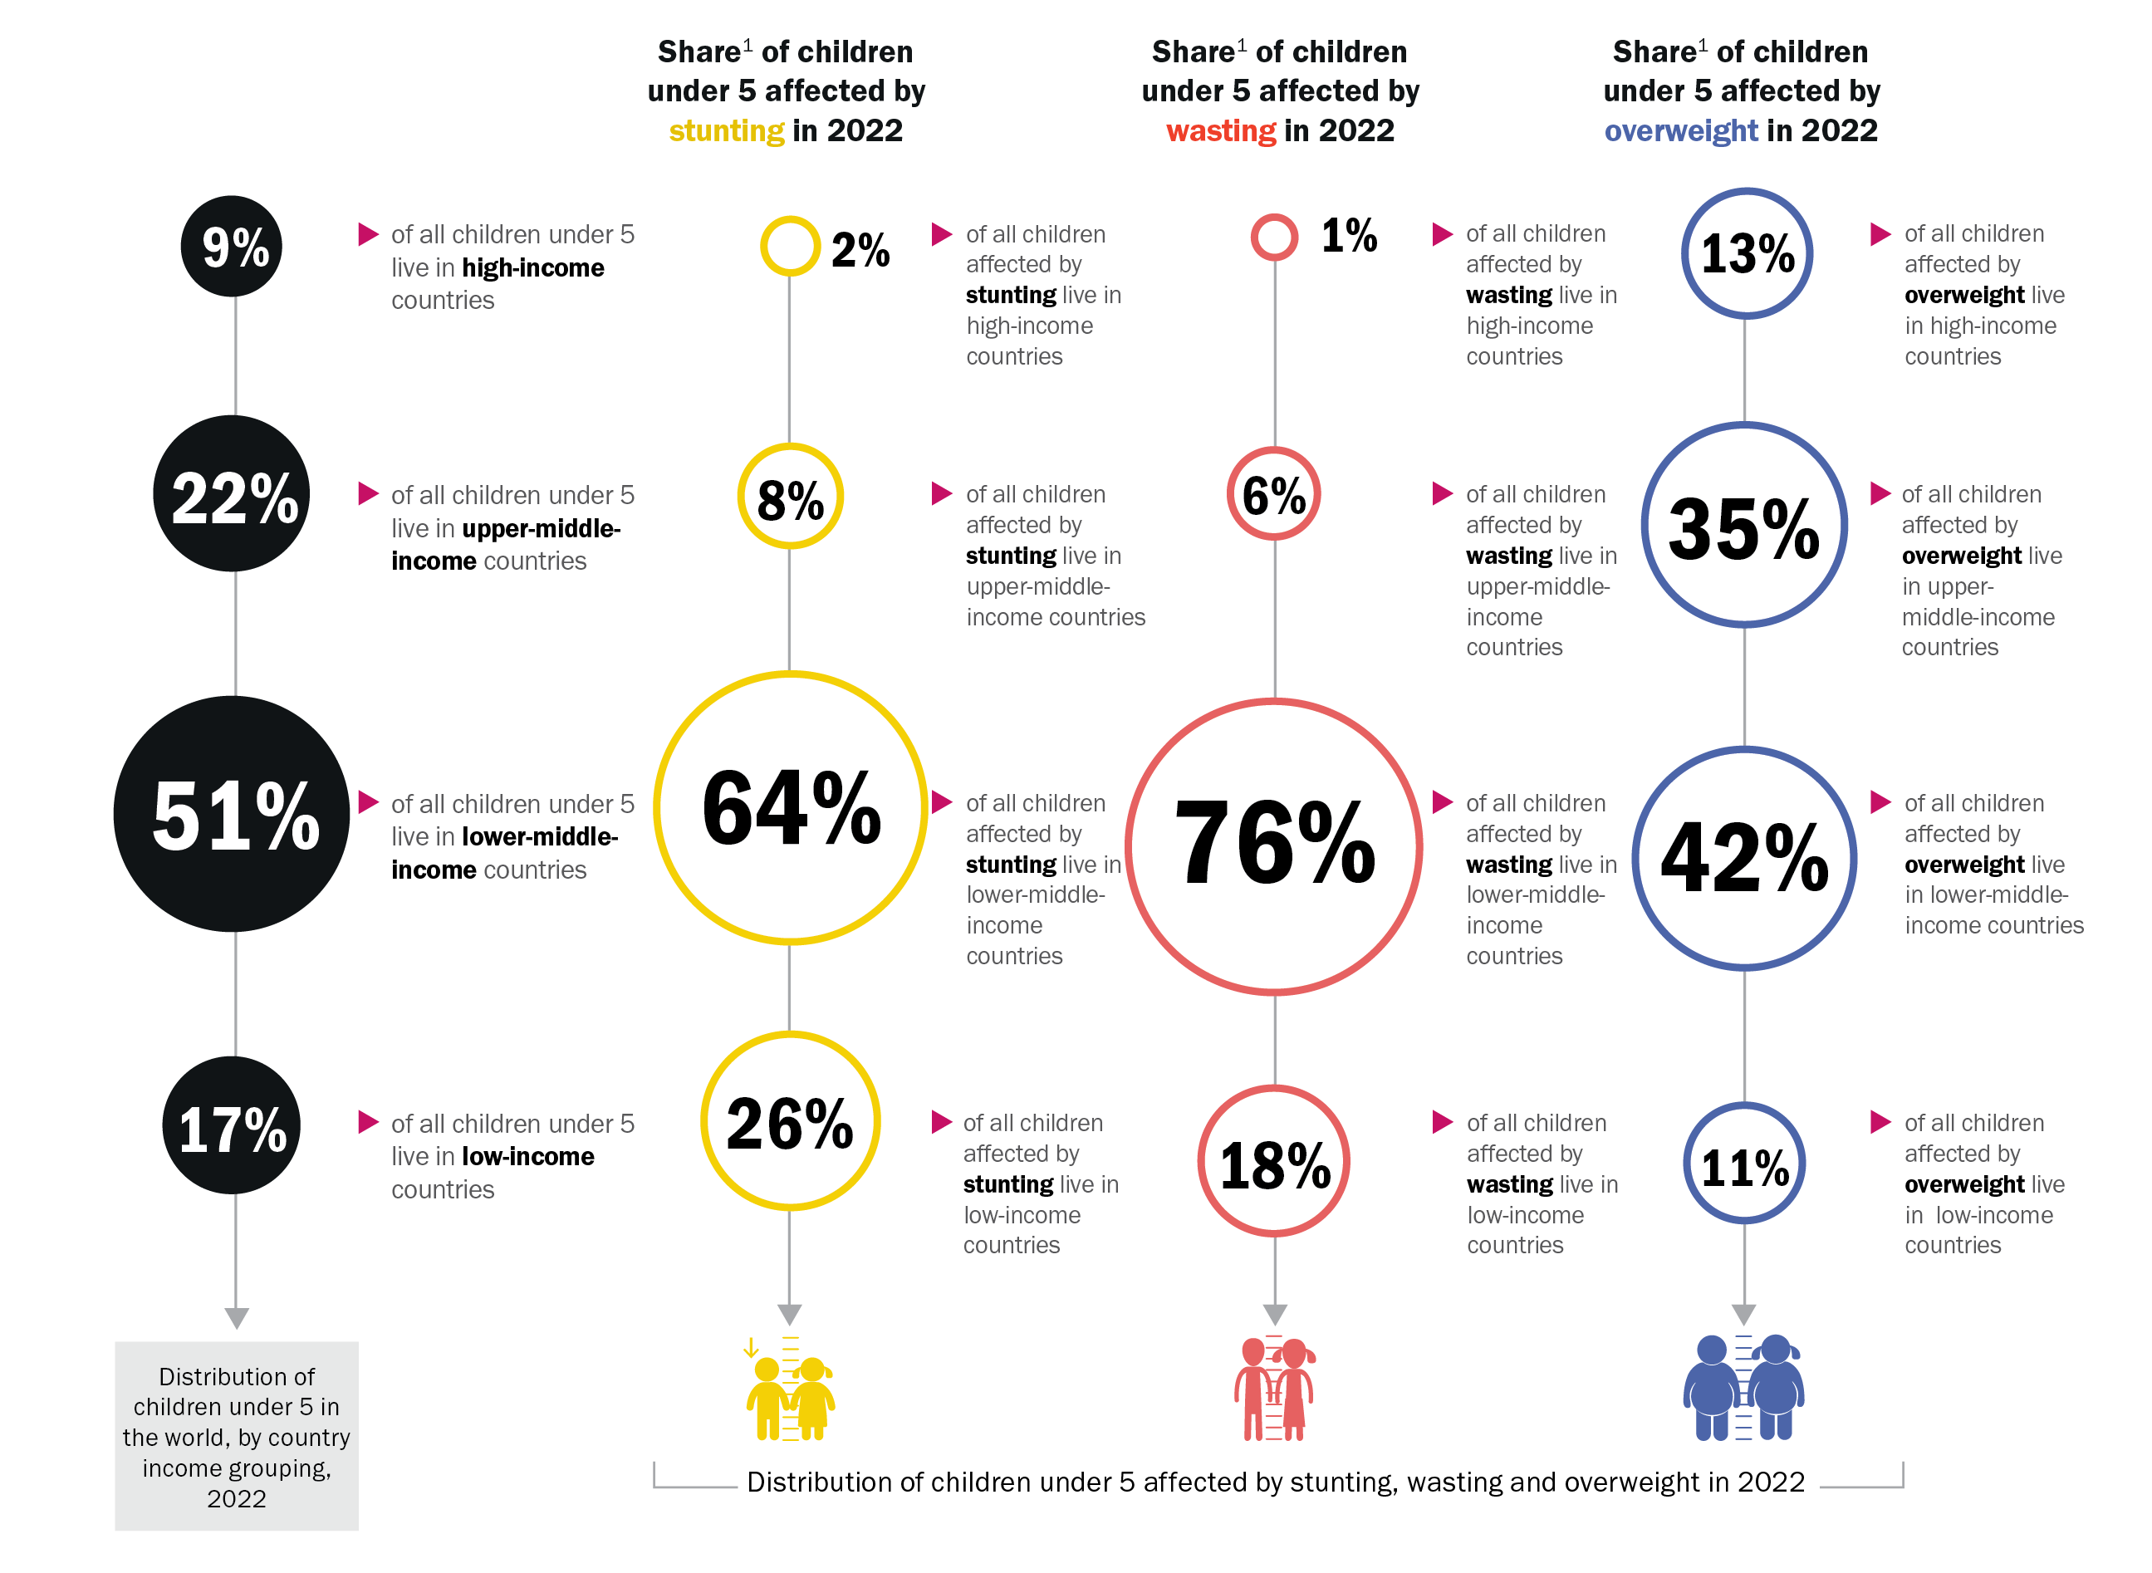
SHARE BY COUNTRY INCOME CLASSIFICATION
While half of all children under 5 live in lower-middle income countries, nearly two thirds of all children with stunting and three quarters of all children with wasting live there
Source: UNICEF, WHO, World Bank Group Joint Malnutrition Estimates, 2023 edition. See notes 1 and 2 in notes section of this slide.
Notes:
Source: UNICEF, WHO, World Bank Group Joint Malnutrition Estimates, 2023 edition. Note: 1. Share is relative to the total number affected across the four country-income groups; this varies from the global totals reported elsewhere in this brochure because the populations are based on the FY2022 World Bank income classification. The differences are as follows: Stunting official global estimate of 148.1 million; sum of four country-income groups = 147.7 million. Wasting official global estimate of 45.0 million; sum of country-income groups = 42.8 million. Overweight official global estimate of 37.0 million; sum of 4 country-income groups = 36.8 million. The percentages for distribution of children under 5, wasting and overweight do not add up to 100 per cent due to rounding.

Slide 9
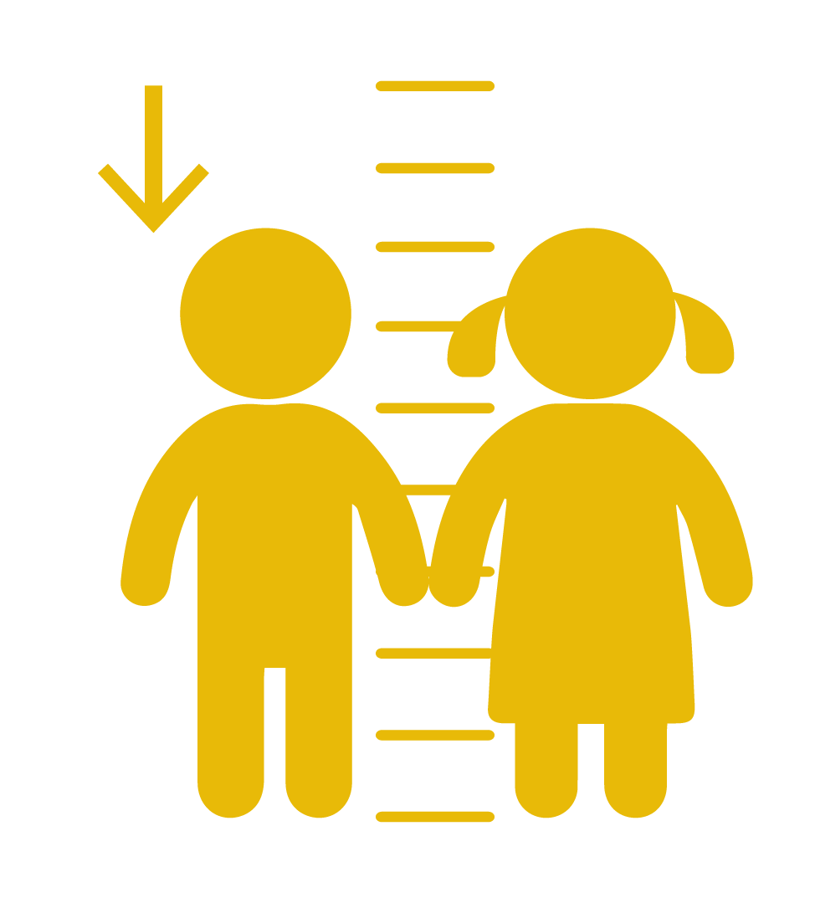
Stunting refers to a child who is too short for his or her age. These children can suffer severe irreversible physical and cognitive damage that accompanies stunted growth. The devastating effects of stunting can last a lifetime and even affect the next generation.

Slide 10
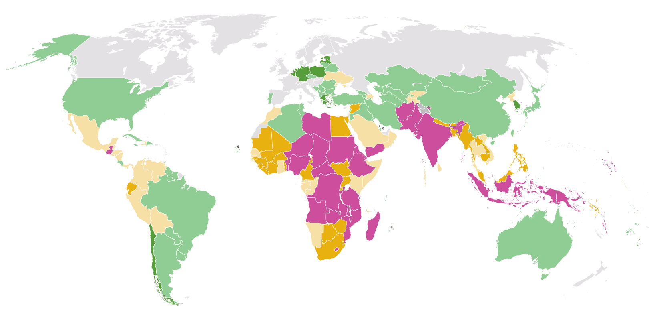
STUNTING
Prevalence, by country, 2022
Percentage of children under 5 affected by stunting, by country, 2022
≥30% (very high)
20 – <30% (high)
10 – <20% (medium)
2.5 – <10% (low)
<2.5% (very low)
Modeled estimate not available
Source: UNICEF, WHO, World Bank Group, Joint Child Malnutrition Estimates, 2023 edition.
Note: * The most recent country data point (e.g., from household surveys) used to generate the modelled stunting and overweight estimates is from before the year 2000; interpret with caution.
These maps are stylized and not to scale; they do not reflect a position by UNICEF, WHO or World Bank Group on the legal status of any country or territory or the delimitation of any frontiers.

Slide 11
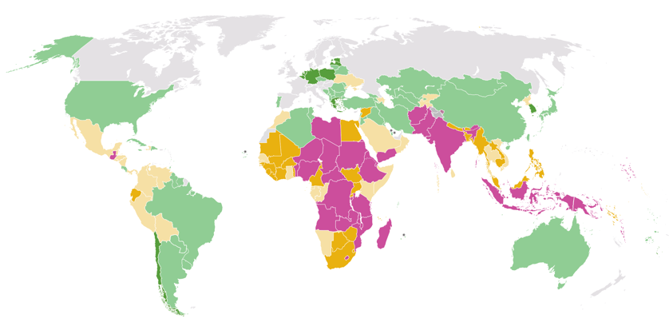
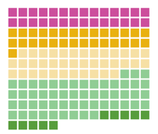
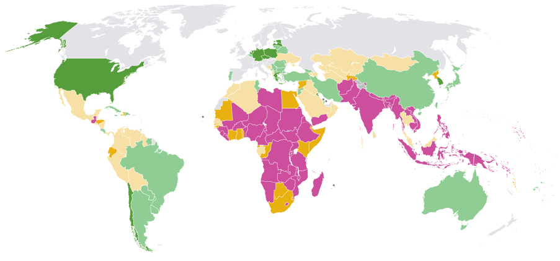
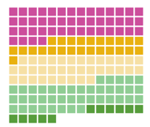
STUNTING
Prevalence, by country, 2022 and 2012
Percentage of children under 5 affected by stunting, by country, 2022 and 2012
2022
≥30% (very high)
20 – <30% (high)
10 – <20% (medium)
2.5 – <10% (low)
<2.5% (very low)
Modeled estimate not available
Distribution of stunting prevalence for each country with a modelled estimate presented for 2022
2012
Source: UNICEF, WHO, World Bank Group, Joint Child Malnutrition Estimates, 2023 edition.
Note: * The most recent country data point (e.g., from household surveys) used to generate the modelled stunting and overweight estimates is from before the year 2000; interpret with caution.
These maps are stylized and not to scale; they do not reflect a position by UNICEF, WHO or World Bank Group on the legal status of any country or territory or the delimitation of any frontiers.
Distribution of stunting prevalence for each country with a modelled estimate presented for 2012

Slide 12
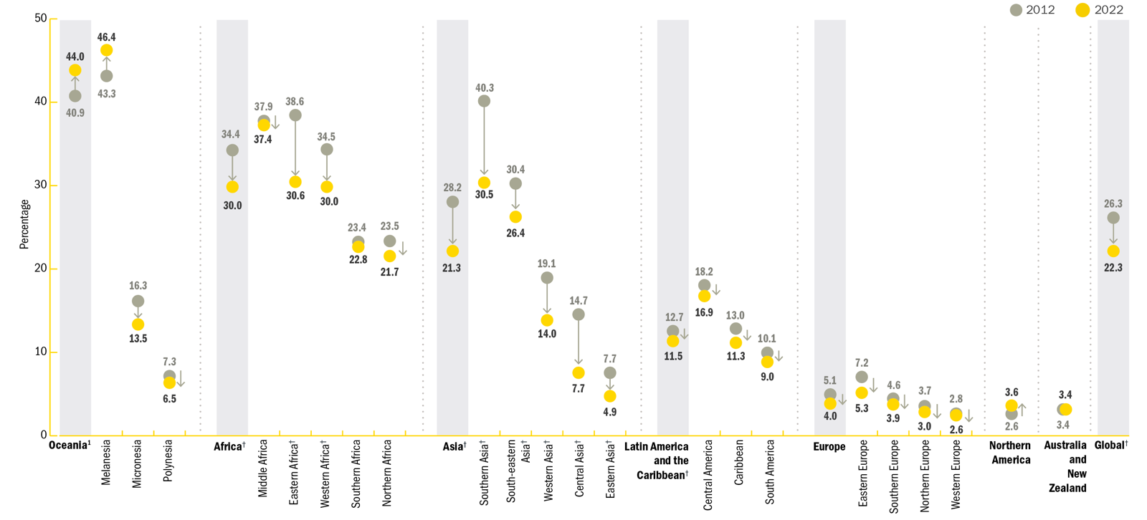
STUNTING
Trends: Prevalence, by UN region/sub-region, 2012 and 2022
Trends in the percentage of children under 5 affected by stunting, by United Nations region/sub-region, 2012 and 2022
Source: UNICEF, WHO, World Bank Group Joint Malnutrition Estimates, 2023 edition. Note: 1. Oceania excluding Australia and New Zealand. †Represents regions/sub-regions where the change has been statistically significant. See tables in JME Report for the 95% confidence intervals for graphed estimates.

Slide 13
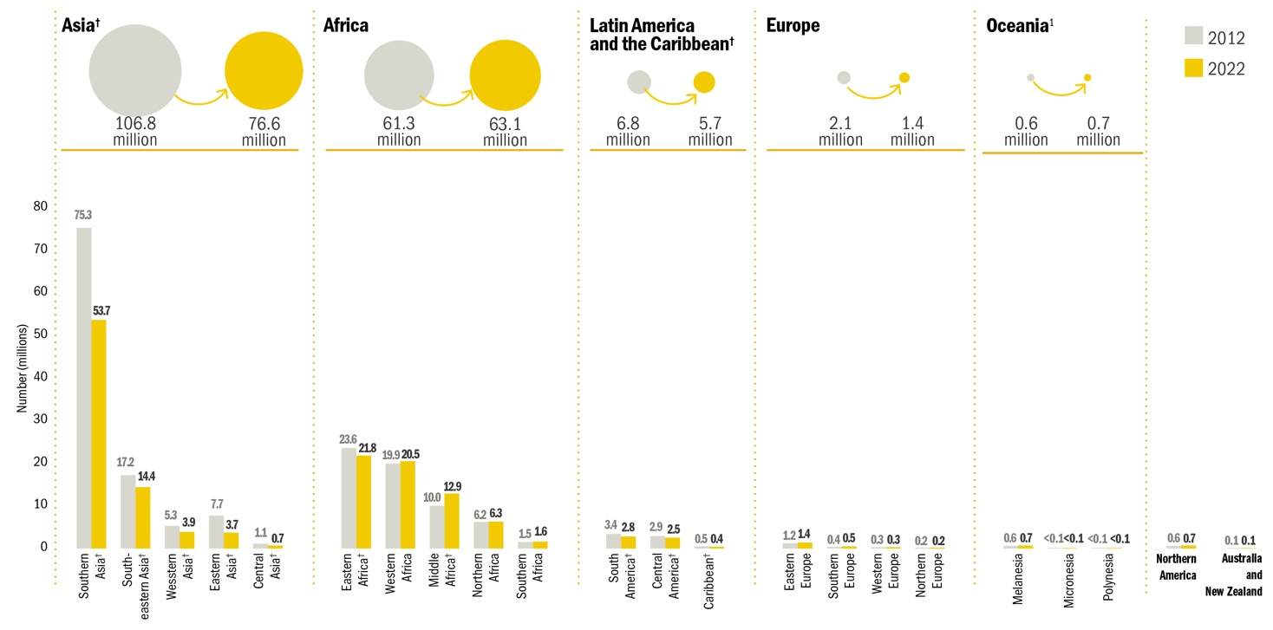
STUNTING
Trends: Number (millions) affected, by UN region/sub-region, 2012 and 2022
Trends in the number (millions) of children under 5 affected by stunting, by United Nations region/sub-region, 2012 and 2022
Source: UNICEF, WHO, World Bank Group Joint Malnutrition Estimates, 2023 edition.
Note: 1. Oceania excluding Australia and New Zealand; †Represents regions/sub-regions where the change has been statistically significant. See tables in JME Report for the 95% confidence intervals for graphed estimates.

Slide 14

Wasting refers to a child who
is too thin for his or her height.
Wasting is the result of recent
rapid weight loss or the failure
to gain weight. A child who is
moderately or severely wasted
has an increased risk of death,
but treatment is possible.

Slide 15
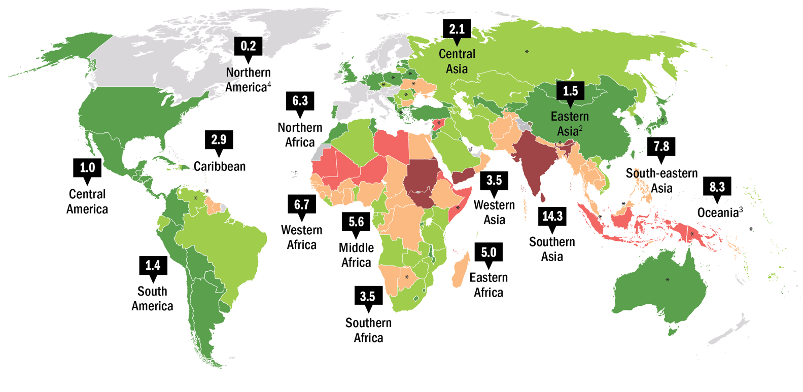
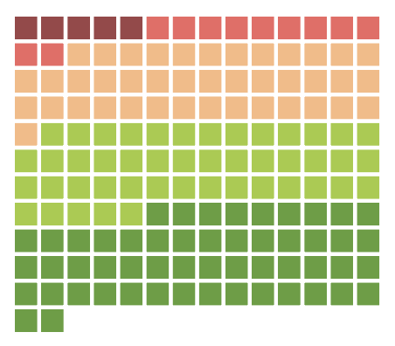
WASTING
Prevalence, by country and UN sub-region, 2022
Percentage of children under 5 affected by wasting, by country and United Nations sub-region, 2022
≥15% (very high)
10 – <15% (high)
5 – <10% (medium)
2.5 – <5% (low)
<2.5% (very low)
no data
Distribution of wasting prevalence, by country, using the most recent available survey between 2012 and 2022
Source: UNICEF, WHO, World Bank Group, Joint Child Malnutrition Estimates, 2023 edition. See notes below.
Notes:
Note: 1. Country data are the most recent available survey estimates between 2012 and 2022; exceptions where older data are shown (2000–2011) are denoted with an asterisk (*) and where only data prior to 2000 are available the † footnote is used, denoting no recent data. 2. Eastern Asia excluding Japan. 3. Oceania excluding Australia and New Zealand. 4. The Northern America sub-regional estimate is based on data from only the United States. There is no estimate available for the sub-regions of Europe or Australia and New Zealand due to insufficient population coverage. See section in JME Report about regional and global estimates on page 27 for an explanation of why trend data are not available for wasting. These maps are stylized and not to scale; they do not reflect a position by UNICEF, WHO or World Bank Group on the legal status of any country or territory or the delimitation of any frontiers.

Slide 16
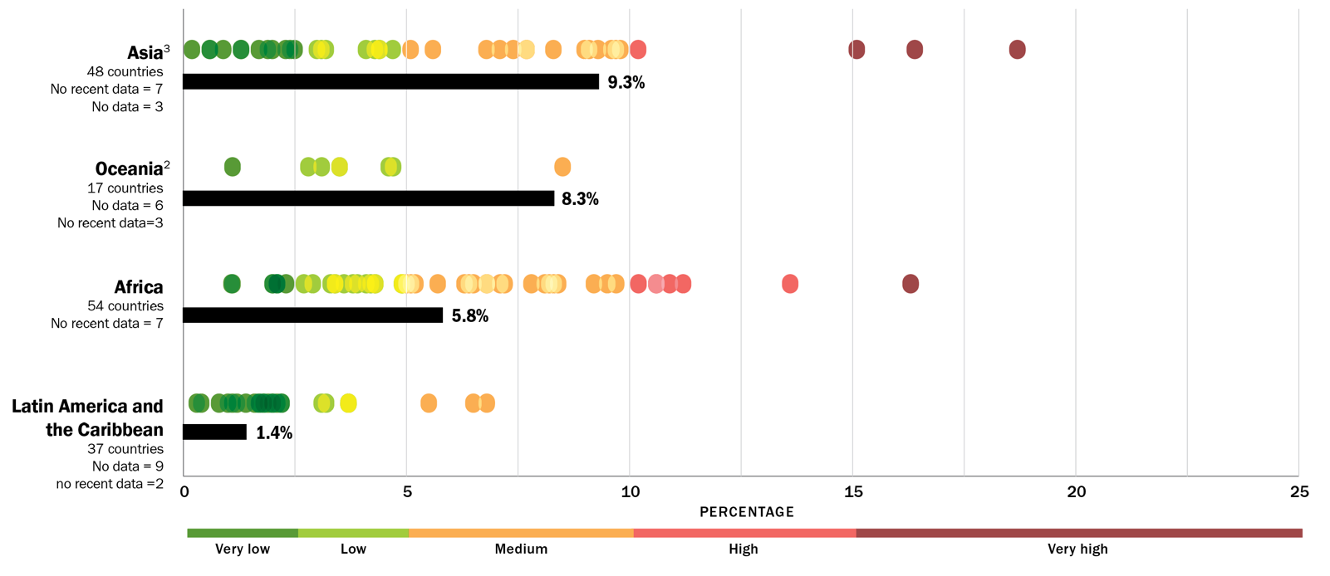
WASTING
Prevalence, by country and UN region, 2022
Percentage of children under 5 affected by wasting, by country (dots) and United Nations region (bars), 2022
Source: UNICEF, WHO, World Bank Group joint malnutrition estimates, 2023 edition. Notes: 1. Each marker refers to the most recent country estimate between 2012 and 2022; “no recent data” refers to the number of countries for which the most recent estimate is before 2012 and “no data” refers to the number of countries without an estimate. 2. Oceania excluding Australia and New Zealand. 3. Asia excluding Japan. There is no estimate available for Europe or Australia and New Zealand due to insufficient population coverage. Northern America is not shown as it only includes two countries, of which only one has data.

Slide 17
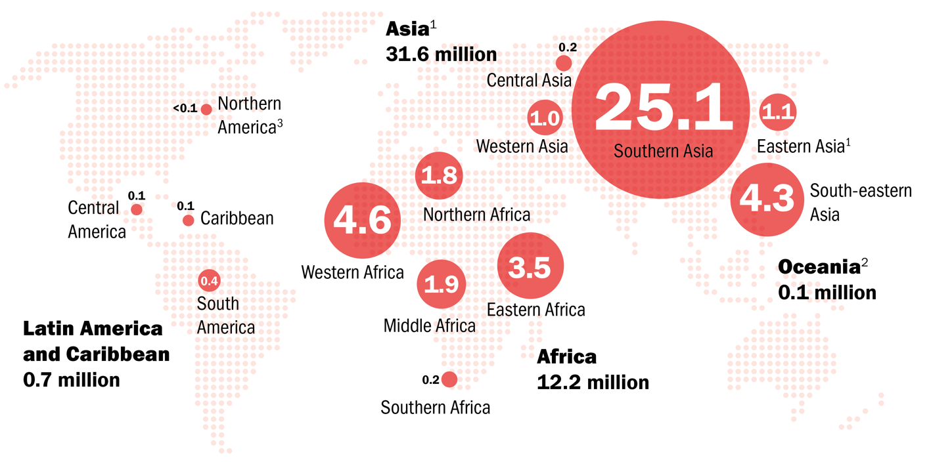
WASTING
Number (millions) affected, by UN sub-region, 2022
Number (millions) of children under 5 affected by wasting, by United Nations sub-region, 2022
Source: UNICEF, WHO, World Bank Group Joint Malnutrition Estimates, 2023 edition. Note: 1. Asia and Eastern Asia excluding Japan. 2. Oceania excluding Australia and New Zealand. 3. The Northern America sub-regional estimate is based on data from only the United States. There is no estimate available for Europe or Australia and New Zealand due to insufficient population coverage. Aggregates may not add up due to rounding and/or lack of estimates for some regions. See section about regional and global estimates on page 27 of the JME Report for an explanation of why regional trend data are not available for wasting.
Notes:
See section in JME Report about regional and global estimates on page 27 for an explanation of why trend data are not available for wasting.

Slide 18
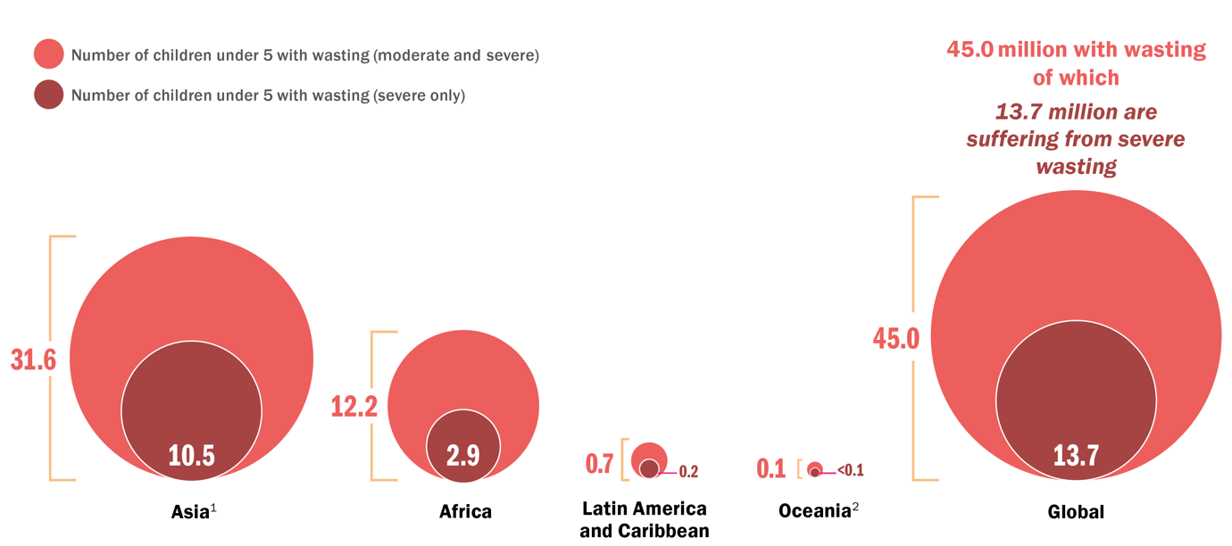
WASTING
Number (millions) affected, wasted and severely wasted, by UN region, 2022
Number (millions) of children under 5 affected by wasting and severe wasting, by United Nations region, 2022
Source: UNICEF, WHO, World Bank Group Joint Malnutrition Estimates, 2023 edition. Note: 1. Asia excluding Japan. 2. Oceania excluding Australia and New Zealand. There is no estimate available for Europe or Australia and New Zealand due to insufficient population coverage. Northern America is not shown because wasting affects <0.1 million children. Aggregates may not add up due to rounding and/or lack of estimates for some regions. See section about regional and global estimates on page 27 of the JME Report for an explanation of why regional trend data are not available for wasting or severe wasting.
Notes:
There is no estimate available for Europe or Australia and New Zealand due to insufficient population coverage. Northern America is not shown as wasting affects <0.1 million children. Aggregates may not add up due to rounding and/or lack of estimates for some regions.
See section in JME Report about regional and global estimates on page 27 for an explanation of why trend data are not available for wasting or severe wasting.

Slide 19
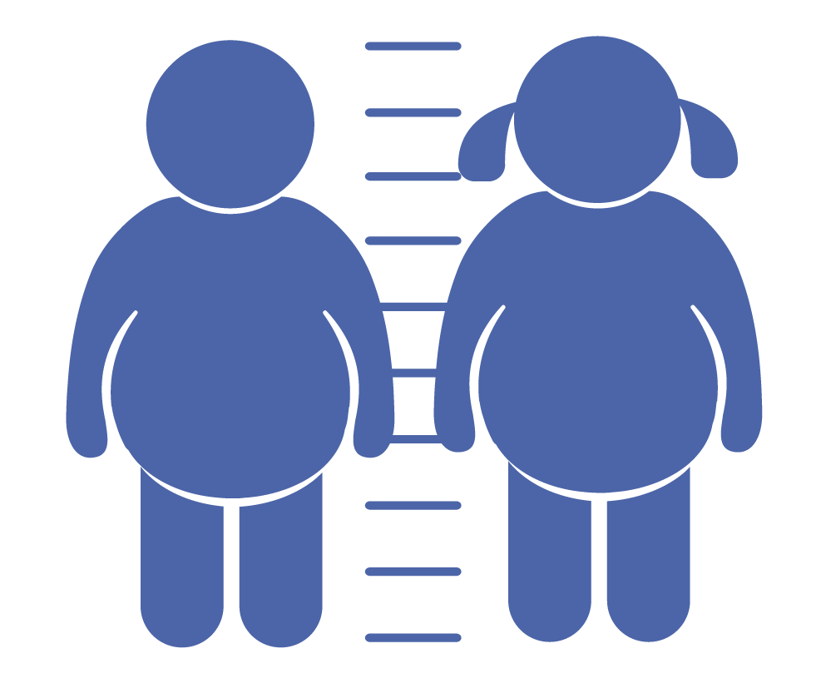
Overweight refers to a child
who is too heavy for his or her
height. This form of malnutrition results from energy intakes from
food and beverages that exceed
children’s energy requirements.
Overweight increases the risk of diet-related non-communicable
diseases later in life.

Slide 20
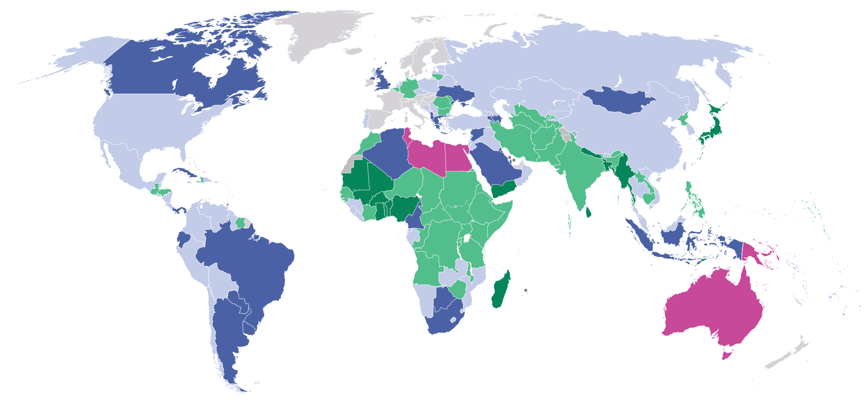
OVERWEIGHT
Prevalence, by country, 2022
Percentage of children under 5 affected by overweight, by country,
2022
≥15% (very high)
10 – <15% (high)
5 – <10% (medium)
2.5 – <5% (low)
<2.5% (very low)
Modeled estimate not available
Source: UNICEF, WHO, World Bank Group, Joint Child Malnutrition Estimates, 2023 edition.
Note: These maps are stylized and not to scale and do not reflect a position by UNICEF, WHO or World Bank Group on the legal status of any country or territory or the delimitation of any frontiers.

Slide 21

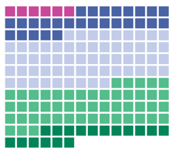
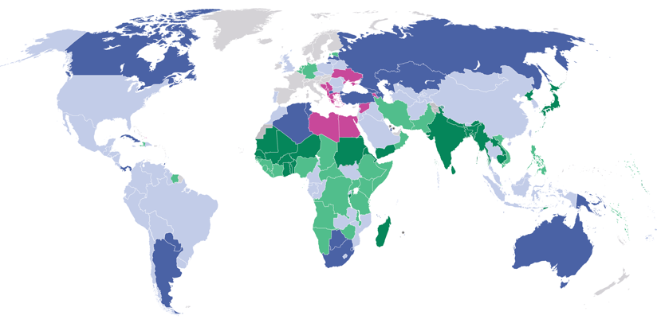
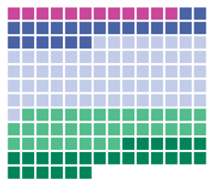
OVERWEIGHT
Prevalence, by country, 2022 and 2012
2022
Percentage of children under 5 affected by overweight, by country, 2022 and 2012
≥15% (very high)
10 – <15% (high)
5 – <10% (medium)
2.5 – <5% (low)
<2.5% (very low)
Modeled estimate not available
Distribution of overweight prevalence for each country with a modelled estimate presented for 2020.¹
2012
Source: UNICEF, WHO, World Bank Group, Joint Child Malnutrition Estimates, 2023 edition. Note: These maps are stylized and not to scale and do not reflect a position by UNICEF, WHO or World Bank Group on the legal status of any country or territory or the delimitation of any frontiers.
Distribution of overweight prevalence for each country with a modelled estimate presented for 2000.

Slide 22
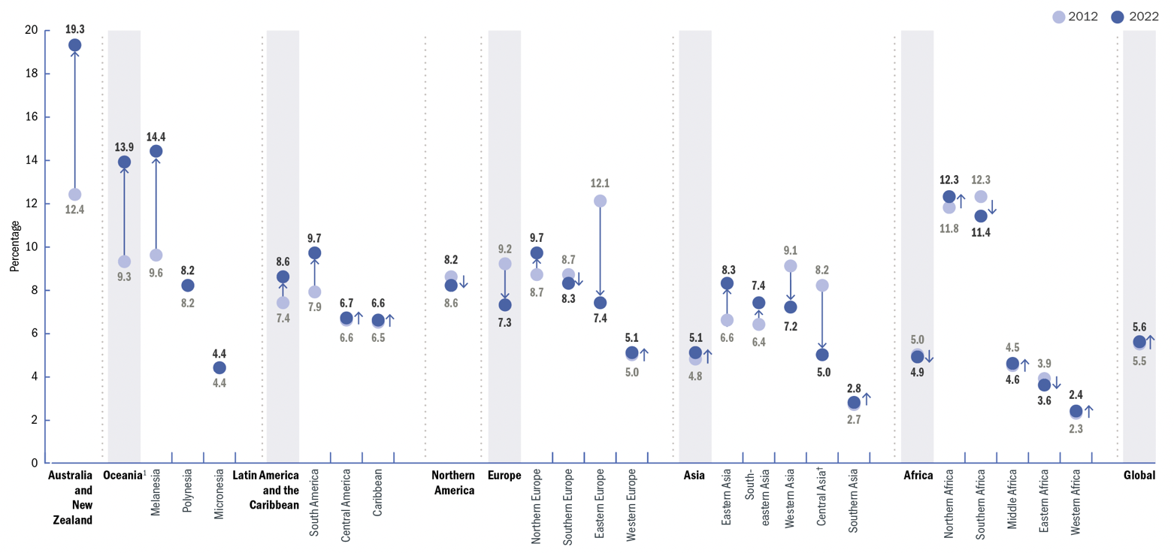
STUNTING
Trends: Prevalence, by UN region/sub-region, 2012—2022
Trends in the percentage of children under 5 affected by overweight, by United Nations region/sub-region and global, 2012–2022
Source: UNICEF, WHO, World Bank Group Joint Malnutrition Estimates, 2023 edition. Note: 1. Oceania excluding Australia and New Zealand. †Represents regions/sub-regions where the change has been statistically significant. See page 14 of the JME Report for the 95% confidence intervals for graphed estimates.

Slide 23
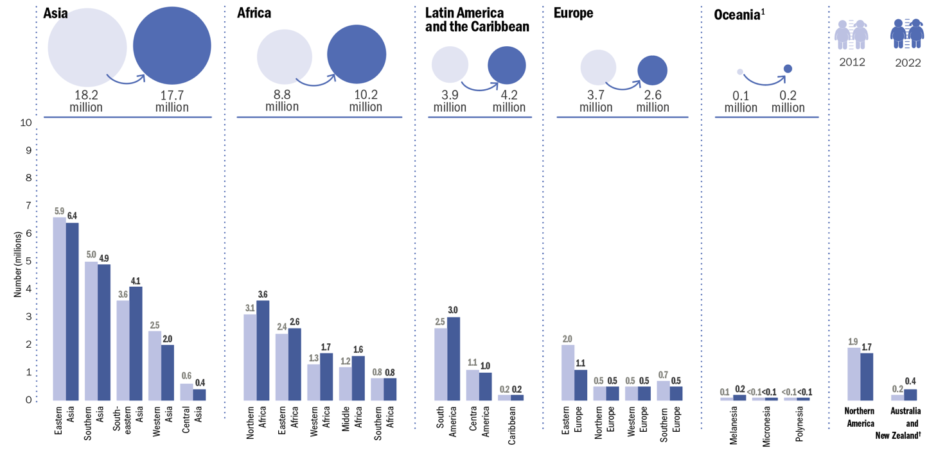
OVERWEIGHT
Trends: Number (millions) affected, by UN region/sub-region, 2012 & 2022
Number (millions) of children under 5 affected by overweight, by United Nations region/sub-region, 2012 and 2022
Source: UNICEF, WHO, World Bank Group Joint Malnutrition Estimates, 2023 edition. Note: 1. Oceania excluding Australia and New Zealand. †Represents regions/sub-regions where the change has been statistically significant. See page 15 of the JME Report for the 95% confidence intervals for graphed estimates.

Slide 24
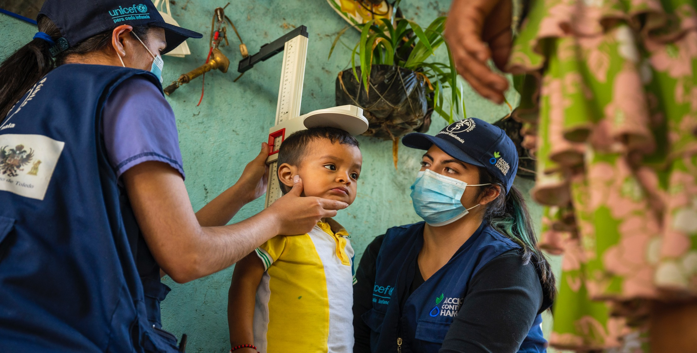
NOTES ON THE DATA
AND METHODOLOGY
UNICEF, WHO, The World Bank. Levels and trends in child malnutrition: Key findings of the 2023 Edition of the Joint Child Malnutrition Estimates – UNICEF | for every child

Slide 25



Overview of JME methodology
The UNICEF-WHO-World Bank JME Working Group was established in 2011 to address the call for harmonized child malnutrition estimates that would be instrumental in benchmarking progress on child malnutrition. The first edition of the JME was released in 2012 and provided estimates for stunting, wasting, severe wasting, underweight and overweight, as well as a detailed description of the methodology. Since its inception, the JME outputs have comprised a harmonized country-level dataset of primary data (e.g., national estimates based on household surveys), as well as regional and global model-based estimates.
Since the 2021 edition, the JME also includes country-level modelled estimates for stunting and overweight based on updated methodology developed by the JME Working Group in partnership with the University of South Carolina. The regional and global figures for stunting and overweight are now also based on these country model outputs, while they remain based on the previously applied sub-regional model for wasting and severe wasting. Additional work is ongoing to update methods for wasting and severe wasting for which available data are not as stable as for stunting and overweight.
The JME process for the current edition involved the following steps:
  (i) updating of the country dataset of primary sources (e.g., national household surveys)
  (ii) application of a country level model for stunting and overweight to generate annual estimates
  (iii) generation of regional and global aggregates for stunting, wasting, severe wasting and overweight
  (iv) consultation with countries before finalizing and disseminating the updated estimates.

Slide 26



Country-level dataset
The JME dataset of country estimates requires the collection of national data sources that contain information on child malnutrition – specifically, data on the height, weight and age of children under 5, which can be used to generate national-level prevalence estimates for stunting, wasting, severe wasting and overweight. These national-level data sources are mainly comprised of household surveys – e.g., Multiple Indicator Cluster Surveys (MICS), Demographic and Health Surveys (DHS), Standardized Monitoring and Assessment of Relief and Transition (SMART) surveys and the Living Standards Measurement Study (LSMS). Some administrative data sources (e.g., from surveillance systems) are also included where population coverage is high. As of the latest review closure on 10 March 2023, the primary source dataset contained 1,100 data sources from 160 countries and territories, with nearly two thirds of children living in countries with at least one data point on stunting, wasting and overweight that is less than five years old (see figure on slide 32). This suggests that the global estimates are highly representative of the majority of children across the globe for the most recent period, although recentness of data varies greatly by region.
The dataset contains the point estimate, and where available, the standard error, the 95 per cent confidence bounds and the unweighted sample size. Where microdata are available, the JME uses estimates that have been recalculated to adhere to the global standard definition.¹ Where microdata are not available, reported estimates are used, except in cases where adjustments are required to standardize for: (i) use of an alternate growth reference from the 2006 WHO Growth Standards; (ii) age ranges that do not include the full 0–59-month age group; and (iii) data sources that were only nationally representative for populations residing in rural areas. Further details related to data source compilation, re-analysis of microdata, and data source review are provided elsewhere. ²
Stunting and Overweight
For stunting and overweight, the JME country dataset is used to generate country-modelled estimates which serve as the official JME estimates (i.e., the stunting prevalence from a household survey for a given country in given year is not reported as the prevalence for that country in that year; rather, it feeds into the modelled estimates).
Wasting
For wasting and severe wasting, the JME country dataset serves as the country estimates themselves (i.e., the wasting prevalence in the JME country dataset from a household survey for a country in a given year is the wasting prevalence reported for that country in that year).
References
1 United Nations Children’s Fund, World Health Organization, The World Bank. UNICEF-WHO-World Bank Joint Child Malnutrition Estimates. (UNICEF, New York; WHO, Geneva; The World Bank, Washington, DC; 2012).
2. United Nations Children’s Fund, World Health Organization and World Bank Group, SDG Indicators 2.2.1 on stunting, 2.2.2a on wasting and 2.2.2b on overweight: Country consultation background document 2021, https://data.unicef.org/resources/jme-2021-country-consultations/ accessed April 2023.

Slide 27
Country-Level Model for Stunting and Overweight
Rationale
National surveys are administered sporadically, resulting in sparse data for many countries. This hampers efforts to monitor these countries’ progress towards targets, such as the SDGs. The use of statistical models at country level is important to enable comparisons across countries during the same year, filling in the gaps. In addition, statistical models are an efficient way to adjust for unwarranted variability
Model Description
The technical details of the statistical models are provided elsewhere.¹ Briefly, for both stunting and overweight, prevalence was modelled at logit (log-odds) scale using a penalized longitudinal mixed-model with a heterogeneous error term. The quality of the models was quantified with model-fit criteria that balance the complexity of the model with the closeness of the fit to the observed data. The proposed method has important characteristics, including non-linear time trends, regional trends, country-specific trends, covariate data and a heterogeneous error term. All countries with data contribute to estimates of the overall time trend and the impact of covariate data on prevalence. For overweight, the covariate data consisted of linear and quadratic socio-demographic index (SDI), and data source type. The same covariates were used for stunting, plus an additional covariate of the average health system access over the previous five years.
Model outcomes
Annual country-level modelled estimates from 2000 to 2022 on stunting and overweight were disseminated in the 2023 JME dataset for 159 countries with at least one data point (e.g., from a household survey) for stunting and 160 countries with at least one data point for overweight. Modelled country estimates were also produced for an additional 43 countries for stunting and 42 for overweight, used solely for generation of regional and global aggregates. Modelled estimates for these countries are not shown because they did not have any household surveys in the JME country dataset. The results for the 205 countries can be used to calculate estimates and uncertainty intervals for any groups of countries aggregated.
The uncertainty intervals are important in monitoring trends, especially for countries with sparse data and where primary data sources present large primary data source sampling errors. When only sparse data are available in the most recent period, the inclusion of a survey can affect a substantial change in the predicted trajectory. For this reason, uncertainty intervals are needed to enhance trend interpretability in terms of the caution level employed. The uncertainty intervals for the JME method have been tested and validated with various data types.
1. United Nations Children’s Fund, World Health Organization and World Bank Group, SDG Indicators 2.2.1 on stunting, 2.2.2a on wasting and 2.2.2b on overweight: Country consultation background document 2021, https://data.unicef.org/resources/jme-2021-country-consultations/ accessed April 2023.

Slide 28



Regional and Global Estimates
Regional and global wasting and severe wasting estimates are only presented for the most recent year, 2022, unlike stunting and overweight estimates for which an annual time series is available from 2000 to 2022. This is because the JME are based on national-level country prevalence data, which come from cross-sectional surveys (i.e., a snapshot at one point in time) that are collected infrequently (every three to five years) in most countries. Since stunting and overweight are relatively stable over the course of a calendar year, it is reasonable to track changes in these two conditions over time with these data, whereas wasting is an acute condition that can change frequently and rapidly. An individual child can be affected by wasting more than once in a calendar year (i.e., can recover but then become wasted again in the same year), and the risk of wasting in many contexts can be driven by seasonal variations, which can result in seasonal spikes in prevalence. For example, wasting prevalence, in some contexts, may double between the post-harvest season (often associated with higher food availability and weather patterns that are less likely to cause disease) and the pre-harvest season (often associated with food shortages, heavy rains and related diseases that can affect nutrition status). Given that country surveys can be collected during any season, the prevalence estimate from any survey may be at a high or low; or it may fall somewhere in between if data collection spanned across several seasons. Thus, the prevalence of wasting captures the situation of wasting at a specific point in time and not over an entire year. Variations in seasons across surveys make it difficult to draw inferences on trends. The lack of methods to account for seasonality and incident cases of wasting and severe wasting are the main reasons why the JME does not present annual trends for these forms of malnutrition.
Generation of Regional and Global Estimates
Stunting and Overweight
Global and regional estimates for all years from 2000 to 2022 were derived as the respective country averages weighted by the under-five population of these countries from The United Nations World Population Prospects, 2022 Revision, using model-based estimates for 205 countries. This includes 159 countries with national data sources for stunting and 160 countries with national data sources for overweight (e.g., household surveys) included in the JME country dataset described above. It also includes countries with modelled estimates generated for development of regional and global aggregates but for which country modelled estimates are not shown because they did not have any household surveys in the JME country dataset (43 countries for stunting and 42 countries for overweight). Confidence intervals were generated based on bootstrapping methodology.
Wasting and severe wasting
The wasting and severe wasting prevalence data from national data sources described in the above section about the JME country dataset were used to generate the regional and global estimates for all years 2000–2022 using the JME sub-regional multi-level model,^{1,2} applying population weights for children under 5 years of age from the United Nations World Population Prospects, 2022 Revision.
In short, results from the new country-level model were used to generate the regional and global estimates for stunting and overweight, while the JME subregional multi-level model was used to generate the global and regional estimates for wasting and severe wasting.
1. United Nations Children’s Fund, World Health Organization, International Bank for Reconstruction and Development/The World Bank, UNICEF-WHO-World Bank Group Joint Child Malnutrition Estimates, UNICEF, New York; WHO, Geneva; World Bank, Washington, DC, 2012.
2. de Onis, Mercedes et al., ‘Methodology for estimating regional and global trends of child malnutrition’, International Journal of Epidemiology, vol., 33, no. 6, December 2004, pps. 1260–1270, <https://doi.org/10.1093/ije/dyh202>, accessed April 2021

Slide 29
Prevalence thresholds for wasting, overweight and stunting in children under 5 years
The thresholds established through the WHO-UNICEF Technical Advisory Group on Nutrition Monitoring (TEAM) were released in 2018.¹ These thresholds have been used in the prevalence-based assessments in maps and tables in this brochure.
The thresholds were developed in relation to standard deviations (SD) of the normative WHO Child Growth Standards. The international definition of ‘normal’ (two SD from the WHO standards median) defines the first threshold, which includes 2.3 per cent of the area under the normalized distribution.
Multipliers of this ‘very low’ level (rounded to 2.5 per cent) set the basis for establishing subsequent thresholds.
Labels | Prevalence thresholds (%)
 | Stunting | Overweight and Wasting
Very Low | <2.5 | <2.5
Low | 2.5 – < 10 | 2.5 – < 5
Medium | 10 – < 20 | 5 – < 10
High | 20 – < 30 | 10 – < 15
Very high | ≥ 30 | ≥ 15
1 de Onis, M., et al. (2018). Prevalence thresholds for wasting, overweight and stunting in children under 5 years. Public health nutrition, 22(1), 175–179.

Slide 30
2025 and 2030 global targets on stunting, wasting and overweight among children under 5 years of age
Progress towards the 2030 SDG was assessed using the 2030 targets proposed as an extension of the 2025 global nutrition targets.
Indicators | Global Nutrition Targets*
 | 2025 Target | 2030 Target
Stunting | Reduce the number of children under 5 who are stunted by 40% | Reduce the number of children under 5 who are stunted by 50%
Wasting | Reduce and maintain childhood wasting to less than 5% | Reduce and maintain childhood wasting to less than 3%
Overweight | No increase in childhood overweight prevalence | Reduce and maintain childhood overweight to less than 3%
Note: *Targets were set using a baseline year of 2012.
References:
United Nations Children’s Fund, World Health Organization, The World Bank. UNICEF-WHO-World Bank Joint Child Malnutrition Estimates. (UNICEF, New York; WHO, Geneva; The World Bank, Washington, DC; 2012). UNICEF & WHO. 2017. Methodology for monitoring progress towards the global nutrition targets for 2025 – technical report. New York, USA and Geneva, Switzerland. https://data.unicef.org/resources/methodology-for-monitoring-progress-towards-the-global-nutrition-targets-for-2025. UNICEF & WHO. 2019. The extension of the 2025 Maternal, Infant and Young Child nutrition targets to 2030. New York, USA and Geneva, Switzerland. https://data.unicef.org/resources/who-unicef-discussion-paper-nutrition-targets

Slide 31
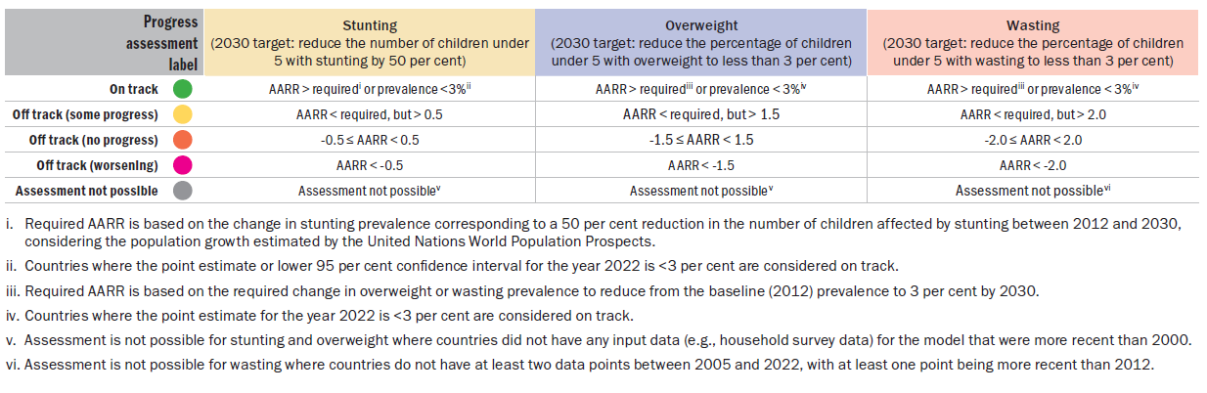
METHODOLOGY
Rules for progress assessment against child malnutrition indicators for SDG target 2.2
Progress was assessed against SDG target 2.2 for 2030* using an adapted version of rules from the WHO-UNICEF Technical Expert Advisory Group on Nutrition Monitoring.** For stunting and overweight, the JME country modelled estimates from 2012 to 2022 were used to calculate the annual average rate of reduction (AARR) for countries with at least one input data point (e.g., from household surveys) more recent than 1999. For wasting, all available country data (e.g., from household surveys) between 2005 and 2022 in the 2023 JME country dataset were used to calculate the AARR for countries with at least two input data points, of which at least one was more recent than 2012. See table below for progress assessment rules by indicator.
References *World Health Organization and United Nations Children’s Fund. ‘WHO/UNICEF discussion paper: The extension of the 2025 maternal, infant and young child nutrition targets to 2030’, WHO and UNICEF, Geneva and New York, 2017, https://data.unicef.org/resources/methodology-for-monitoring-progress-towards-the-global-nutrition-targets-for-2025 accessed April 2023. and **WHO-UNICEF Technical Expert Advisory Group on Nutrition Monitoring, Methodology for Monitoring Progress Towards the Global Nutrition Targets for 2025 – Technical Report, World Health Organization and the United Nations Children’s Fund, 2017. https://data.unicef.org/resources/who-unicef-discussion-paper-nutrition-targets accessed April 2023

Slide 32
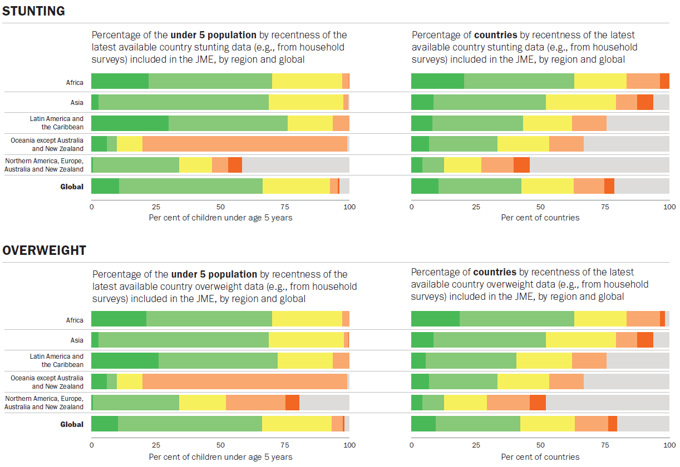
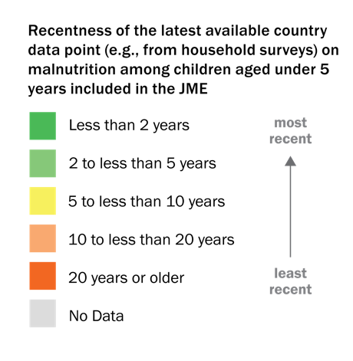
METHODOLOGY
Latest country available data
Globally, two-thirds of children live in countries where at least one data point on stunting, wasting and overweight is less than 5 years old
Note: Figures for wasting are the same as for stunting and are therefore not presented. The population coverage for the most recent five-year period is the value of the two green colors added together (i.e., the population coverage for stunting for the most recent five-year period in Africa is 70 per cent).
Notes:
These graphics show the recentness of the latest available country data points on malnutrition (e.g., from a household survey) among children under 5 years in the JME. The graphics in the left-hand column are by percentage of the under-five population and the graphics in the right-hand column are by the percentage of countries. Only stunting and overweight are shown because the data for wasting mirror those for stunting.
For the graphics by percentage of the under-five population (left column), the availability of data for each country was weighted by the under-five population, meaning that more populous countries contributed more to the percentages in each category than less populous ones. The more green there is for a region, the higher the percentage of children under 5 living in countries with very recent data (i.e., at least one data point in the last five years); the more orange there is, the higher the percentage of children living in countries with very old data (i.e., the latest data point is 10–20+ years old). Globally, about two-thirds of children live in countries where the malnutrition prevalence data are less than five years old, while less than 5 per cent of children live in countries with no data at all. This suggests that the modelled regional and global estimates are highly representative of the situation of the majority of children across the globe for the most recent period.
The situation by percentage of countries (right-hand column) looks vastly different, with less than half of all countries having at least one data point in the last five years and nearly one quarter of countries with no data at all. This indicates that the governments of many countries will not be able to adequately assess and plan programmes to combat malnutrition.
The recentness of data varies greatly by region. For example, about three quarters of children under 5 in Latin America and Caribbean live in countries with recent data on stunting, wasting and overweight, while only 10 per cent of children in Oceania (excluding Australia and New Zealand) live in countries with recent data. While nearly three quarters of all children under 5 in Latin America and the Caribbean live in countries with recent data, only two in five countries have recent data. Furthermore, 14 countries (nearly two out of five countries in that region) with very small populations have very old (>10 years old) data or no data on child malnutrition at all.
Gaps in the available data make it challenging to accurately estimate the prevalence of malnutrition. Regular data collection is critical to properly plan and monitor programmes to combat child malnutrition at country, regional and global levels going forward.

Slide 33
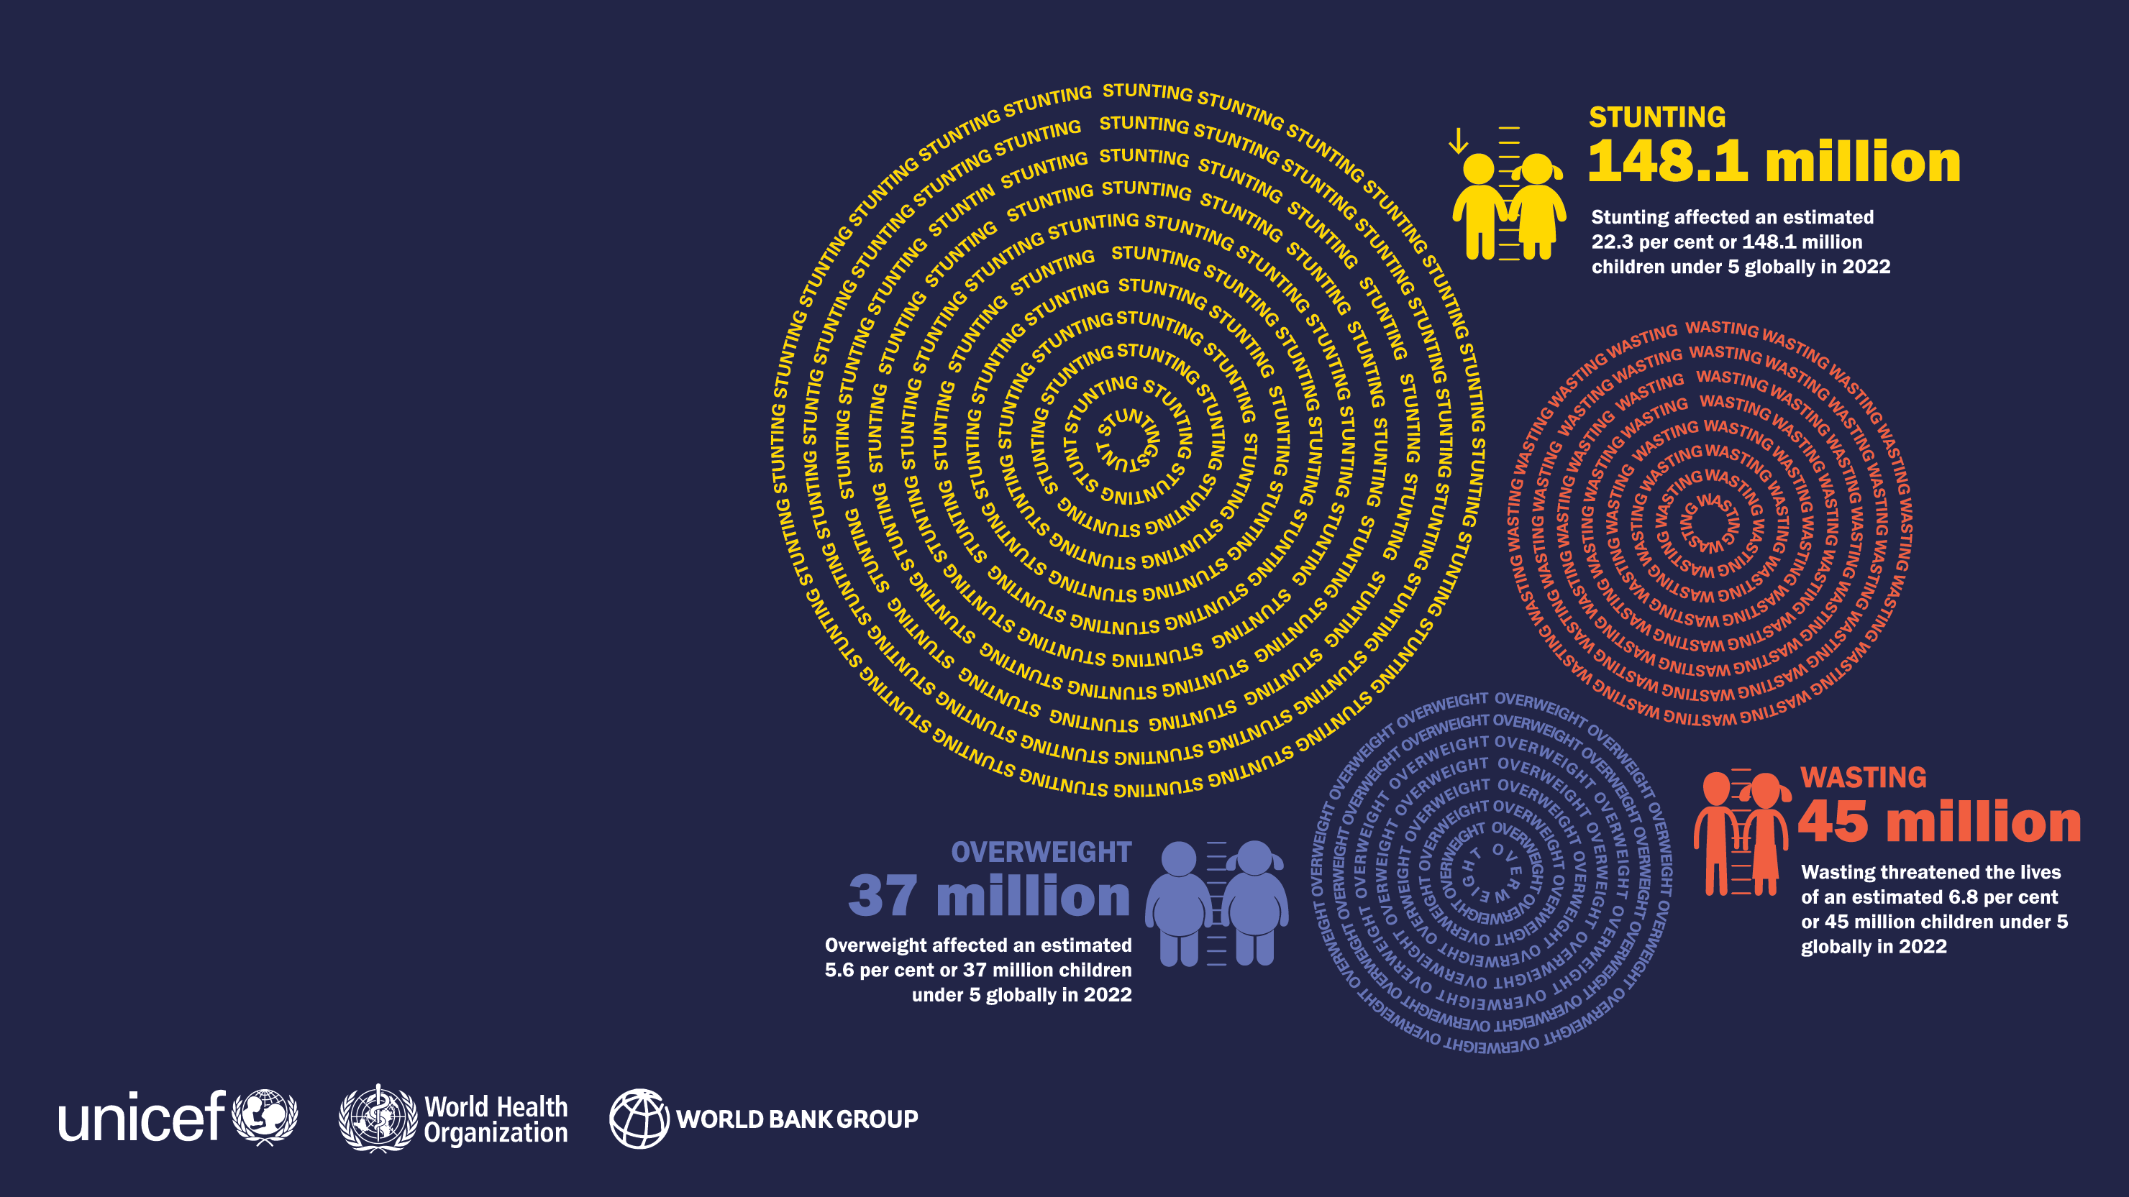
ONLINE
MATERIALS

Slide 34

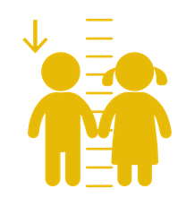
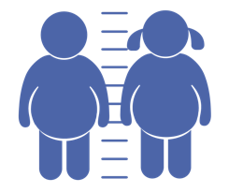

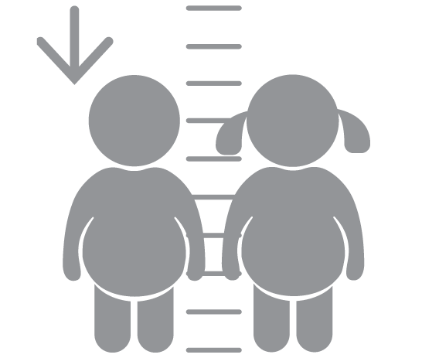
ONLINE MATERIALS
Databases
This key findings presentation of the 2023 edition of the JME summarizes the new country, regional and global numbers and main messages for official United Nations’ data on child malnutrition. Additional information is available, and the following materials can be downloaded from the
link below.
• The latest country-level joint malnutrition dataset, a time series
of country estimates from sources such as household surveys
that were used to generate the joint child malnutrition country,
regional and global modelled estimates for stunting and overweight
and the regional and global modelled estimates for wasting and
severe wasting
• The country modelled estimates for stunting and overweight
• The joint malnutrition global and regional estimates database by
various regional groupings (e.g., United Nations, UNICEF, WHO, etc.)
and for more years than presented in this report
• A reference document outlining the composition of the various
regional groupings for which the joint estimates have been produced
• Interactive dashboards, which allow users to visualize and export the
global and regional estimates for a number of regional groupings
Please see: https://data.unicef.org/resources/jme-report-2023/

Slide 35
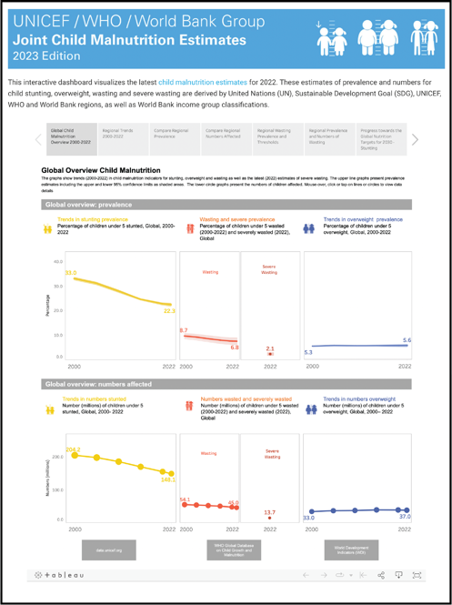
ONLINE MATERIALS
Interactive Dashboards
Interactive dashboards, which allow users to visualize and
export the global and regional estimates for a number of
regional groupings.
Available at: https://uni.cf/JME2023Dashboard

Slide 36
Prepared by:
Data and Analytics Section, Nutrition Data Unit
Division of Data, Analytics, Planning and Monitoring
UNICEF Headquarters
3 UN Plaza, New York, NY, 10017
data.unicef.org
For more information contact:
data@unicef.org

